Slide 1

Real Time Operating Systems
Professor: Mike Aleshams
Winter 2021

Slide 2
Session – January 19

Slide 3
Module I. Describe the high-level operation of real-time embedded systems

Slide 4
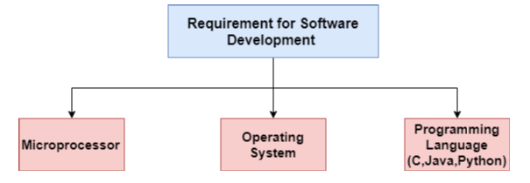
Embedded Software Development
The process of integrating software engineering with non-computer devices is called embedded software development.

Slide 5
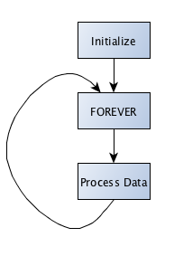
Super-loop Programming
Executing an infinite number of loops in order to ensure that all tasks are performed within the loop is called a super-loop or cyclic execution of programming,
Infinite Loop is a loop that a task keeps executing until the job is either finished or the board is reset. This loop is necessary for embedded software development because embedded software task cannot be accomplished without it.

Slide 6
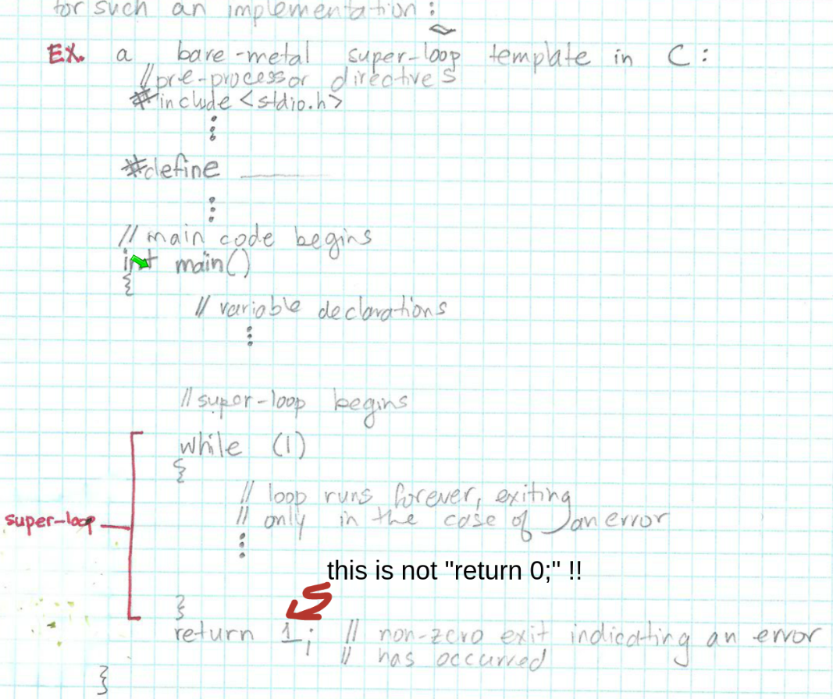
Bare metal Programming
It is an old fashioned programming style that automatically turns on the hardware without the specific requirement of an Operating System(OS).

Slide 7
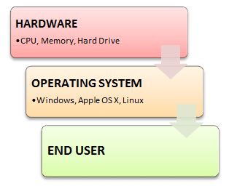
What is an Operating System?
An Operating System (OS) is a software that acts as an interface between computer hardware components and the user. Every computer system must have at least one operating system to run other programs. Applications like Browsers, MS Office, Notepad Games, etc., need some environment to run and perform its tasks.
The OS helps you to communicate with the computer without knowing how to speak the computer's language. It is not possible for the user to use any computer or mobile device without having an operating system.

Slide 8
Types of Operating System (OS)
Batch Operating System
Some computer processes are very lengthy and time-consuming. To speed the same process, a job with a similar type of needs are batched together and run as a group.
The user of a batch operating system never directly interacts with the computer. In this type of OS, every user prepares his or her job on an offline device like a punch card and submit it to the computer operator.
Multi-Tasking/Time-sharing Operating systems
Time-sharing operating system enables people located at a different terminal(shell) to use a single computer system at the same time. The processor time (CPU) which is shared among multiple users is termed as time sharing.

Slide 9
Types of Operating System (OS)
Real time OS, RTOS
In a real time operating system, time interval to process and respond to inputs is very small. Examples: Military Software Systems, Space Software Systems are the Real time OS example.
Distributed Operating System
Distributed systems use many processors located in different machines to provide very fast computation to its users.
Network Operating System
Network Operating System runs on a server. It provides the capability to serve to manage data, user, groups, security, application, and other networking functions.

Slide 10
Operating system requirement in Embedded System
Coordination of multiple concurrent tasks.
Secure and advance communication protocol.
Advanced Graphical User Interface(GUI).
Interaction with mobile and/or other networking devices.
Same features/programs are only available with an OS.
Management of multiple processors.

Slide 11
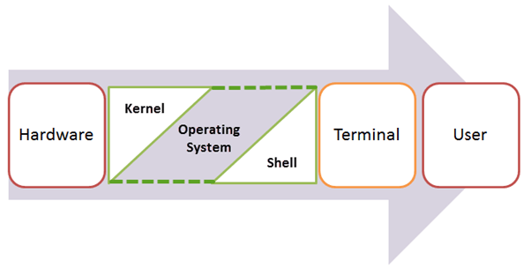
What is a Kernel?
The kernel is the central component of a computer operating systems. The only job performed by the kernel is to manage the communication between the software and the hardware. A Kernel is at the nucleus of a computer. It makes the communication between the hardware and software possible. While the Kernel is the innermost part of an operating system, a shell is the outermost one.

Slide 12
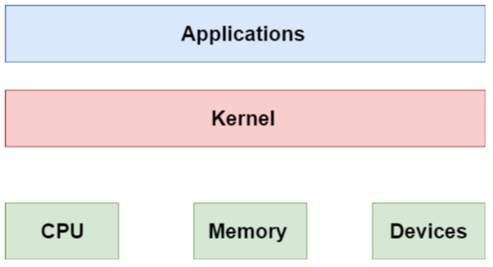
What is a Kernel?
kernel is foundational software that controls or allocates computer resources like CPU cores, RAM, input, output devices, and peripherals.

Slide 13
What is a Kernel?
Types of Kernels
There are many types of kernels that exists, but among them, the two most popular kernels are:
Monolithic
A monolithic kernel is a single code or block of the program. It provides all the required services offered by the operating system. It is a simplistic design which creates a distinct communication layer between the hardware and software. This type of kernel only consists of basic functions.
Microkernels
Microkernel manages all system resources. In this type of kernel, services are implemented in different address space. The user services are stored in user address space, and kernel services are stored under kernel address space. So, it helps to reduce the size of both the kernel and operating system.

Slide 14
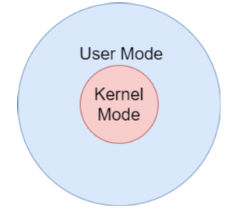
Modes
A processor in a computer running an operating system has two different modes: user mode and kernel mode. The processor switches between the two modes depending on what type of code is running on the processor., and.
Kernel Mode: Core operating system components run in kernel mode This mode provides access to the whole system memory.
User Mode: Applications run in user mode. The user pertains to access to only designated memory areas preventing the privacy of sensitive areas of the memory outside of their scope.

Slide 15
Multi-Tasking Operating System
A multitasking operating system is defined by its ability to support more than one task at the same time. It is achieved by continuously managing large processes in the main memory and using I / O resources among the active tasks.
Technically on a single-core CPU, only one task could be running. However, at any given point in time, Kernel may pre-initialize a process by preferring a context-switch, as a result of which we have the illusion of simultaneous process execution.

Slide 16
What is Pre-emptive Scheduling?
Pre-emptive Scheduling is a scheduling method where the tasks are mostly assigned with their priorities. Sometimes it is important to run a task with a higher priority before another lower priority task, even if the lower priority task is still running.
At that time, the lower priority task holds for some time and resumes when the higher priority task finishes its execution.

Slide 17
What is Pre-emptive Scheduling?
Here, are pros/benefits of Pre-emptive Scheduling method:
Pre-emptive scheduling method is more robust, approach so one process cannot monopolize the CPU
Choice of running task reconsidered after each interruption.
Each event cause interruption of running tasks
The OS makes sure that CPU usage is the same by all running process.
In this, the usage of CPU is the same, i.e., all the running processes will make use of CPU equally.
This scheduling method also improves the average response time.
Pre-emptive Scheduling is beneficial when we use it for the multi-programming environment.

Slide 18
What is Pre-emptive Scheduling?
Here, are cons/drawback of Pre-emptive Scheduling method:
Need more limited computational resources for Scheduling
Takes a higher time by the scheduler to suspend the running task, switch the context, and dispatch the new incoming task.
The process which has low priority needs to wait for a longer time if some high priority processes arrive continuously.

Slide 19
What is Non- Pre-emptive or Cooperative Scheduling?
In this type of scheduling method, the CPU has been allocated to a specific process. The process that keeps the CPU busy will release the CPU either by switching context or terminating.
It is the only method that can be used for various hardware platforms. That's because it doesn't need specialized hardware (for example, a timer) like Pre-emptive Scheduling.
Non-Pre-emptive Scheduling occurs when a process voluntarily enters the wait state or terminates.

Slide 20
What is Non- Pre-emptive or Cooperative Scheduling?
Here, are pros/benefits of Non-Pre-emptive Scheduling method:
Offers low scheduling overhead
Tends to offer high throughput
It is conceptually very simple method
Less computational resources need for Scheduling

Slide 21
What is Non- Pre-emptive or Cooperative Scheduling?
Here, are cons/drawback of Non-Pre-emptive Scheduling method:
It can lead to starvation especially for those real-time tasks
Bugs can cause a machine to freeze up
It can make real-time and priority Scheduling difficult
Poor response time for processes

Slide 22
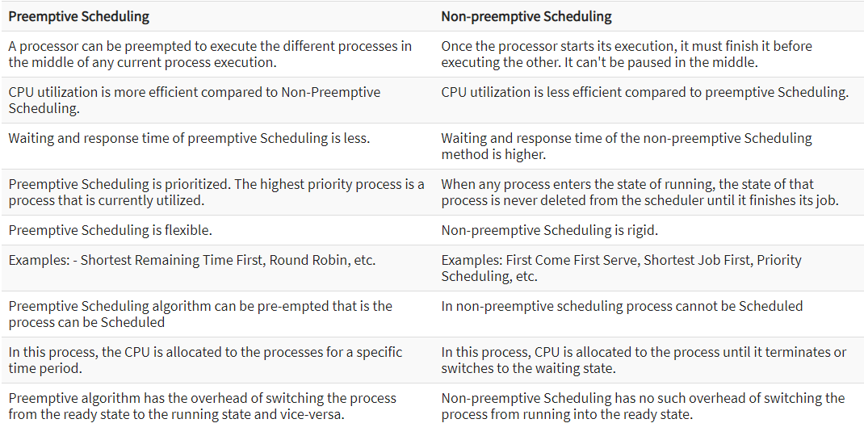
Difference Between Pre-emptive and Non-Pre-emptive Scheduling in OS

Slide 23
Multitasking in Linux
Linux: A well known Multi-tasking OS originally based on UNIX. The original UNIX was written in assembly level language for PDP-7 minicomputer.
UNIX OS was written in C and ported to various platforms, one of them was LINUX.
In Linux, each process occupies a structured area of memory called the “sandbox”. The sandbox is the virtual memory address space that in 32-bit mode and 64-bit mode are 4GB, 8GB blocks of memory respectively. These virtual addresses are finally mapped into the physical memory by page tables.
Older Linux kernels would never allow pre-emption of a task while it was busy running kernel code. But it’s not a case for concurrent Linux kernels any longer.

Slide 24
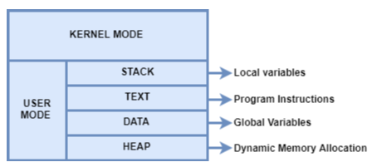
Multitasking in Linux
Each page table virtual memory will be mapped to the physical memory/RAM.

Slide 25
Multitasking in Linux
Multitasking in Linux occurs based on threads. Each thread is essentially a sub-process, can be generated by a couple of functions. These functions are predefined in a thread library called the p-thread library.
Note: p-thread or POSIX thread (Portable OS Interface) is a C source file that can be added to the language C for multitasking.

Slide 26
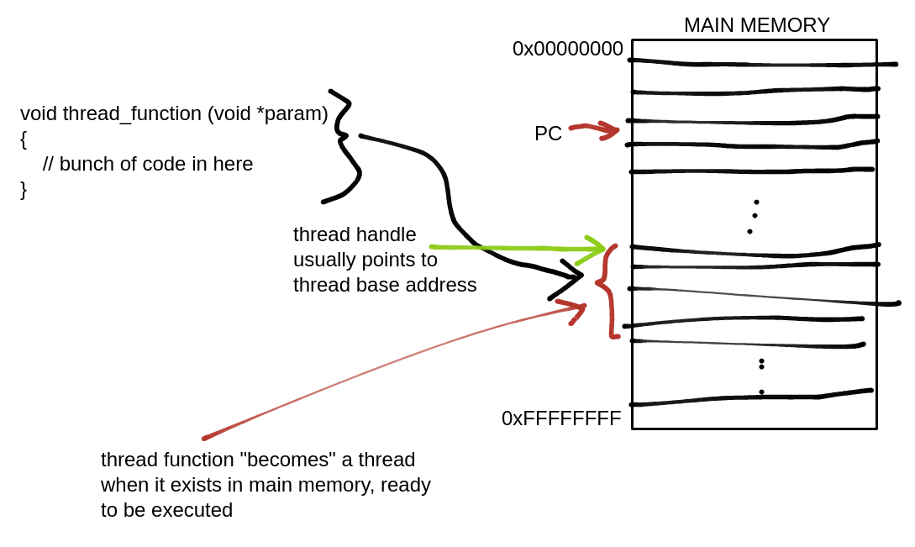
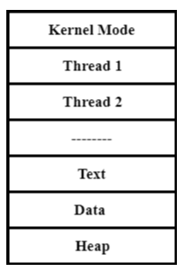
P-threads
Each one has separate stack space, stack pointer, program counter, and guard purpose signal.
They share the same texts, data and data spaces.
They cannot be scheduled consistently by the Kernel and that's the reason LINUX is not an Real-Time operating system (RTOS).

Slide 27
P-threads
Some important p-thread keywords/ functions are,
pthread_t
pthread_create C
pthread_join C
Take a look at a typical pthread multi-tasking_app_preview.c code on the following slide!

Slide 28
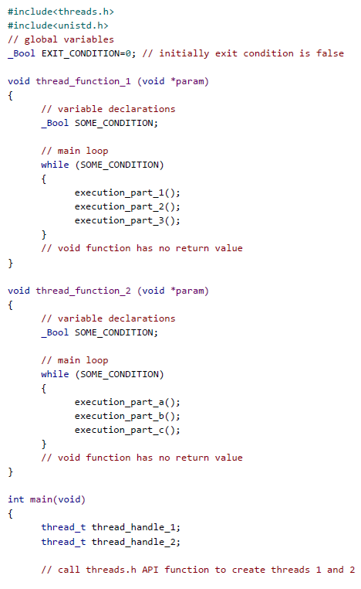
P-threads

Slide 29
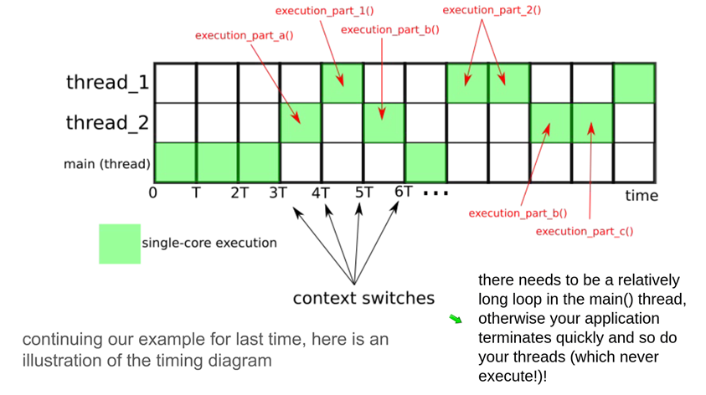
P-threads
Execute and explain multi-tasking_app_preview.c code

Slide 30
Notice for Assignment #1
Make looks for a file called "makefile" or "Makefile" in the same directory; a makefile is a script that make uses to build your application
please look for (and the read the introductory parts to) the GNU make documentation in the teaching repository:
https://github.com/takiszourntos/teaching/blob/master/documentation/gnu-make.pdf
When you develop code for the Beagle bone from now on, it should go like this:
1) Write and debug the code on your desktop/host using the Eclipse IDE
2) Using sftp, send your source code over to the Beagle bone (use tar and gzip to make the project a single, compressed file)
$ tar -cvf project/ project.tar
$ gzip project.tar
$ sftp debian@192.168.7.2 project.tar.gz
3) Write a makefile to build the application on the Beagle bone
4) Use make on the Beagle bone to build the application
BBB:$ make

Slide 31

Have you already prepared the Components for this semester?

Slide 32
What is a Real-Time Operating System (RTOS)?
Real-time operating system (RTOS) is an operating system intended to serve real time application that process data as it comes in, mostly without buffer delay. The full form of RTOS is Real time operating system.
In a RTOS, Processing time requirement are calculated in tenths of seconds increments of time. It is time-bound system that can be defined as fixed time constraints. In this type of system, processing must be done inside the specified constraints. Otherwise, the system will fail.

Slide 33

Real Time Operating System(RTOS)

Slide 34
Why use an RTOS?
It offers priority-based scheduling, which allows you to separate analytical processing from non-critical processing.
The Real time OS provides API functions that allow cleaner and smaller application code.
Abstracting timing dependencies and the task-based design results in fewer interdependencies between modules.
RTOS offers modular task-based development, which allows modular task-based testing.
The task-based API encourages modular development as a task, will typically have a clearly defined role. It allows designers/teams to work independently on their parts of the project.
An RTOS is event-driven with no time wastage on processing time for the event which does not occur

Slide 35
Features of RTOS
Occupy very less memory
Consume fewer resources
Response times are highly predictable
Unpredictable environment
The Kernel saves the state of the interrupted task ad then determines which task it should run next.
The Kernel restores the state of the task and passes control of the CPU for that task.

Slide 36
Factors for selecting an RTOS
Performance: Performance is the most important factor required to be considered while selecting for an RTOS.
Middleware: if there is no middleware support in Real time operating system, then the issue of time-taken integration of processes occurs.
Error-free: RTOS systems are error-free. Therefore, there is no chance of getting an error while performing the task.
Embedded system usage: Programs of RTOS are of small size. So we widely use RTOS for embedded systems.
Maximum Consumption: we can achieve maximum Consumption with the help of RTOS.
Task shifting: Shifting time of the tasks is very less.
Unique features: A good RTS should be capable, and it has some extra features like how it operates to execute a command, efficient protection of the memory of the system, etc.
24/7 performance: RTOS is ideal for those applications which require to run 24/7.

Slide 37
Applications of Real Time Operating System
Airlines reservation system.
Air traffic control system.
Systems that provide immediate updating.
Used in any system that provides up to date and minute information on stock prices.
Defense application systems like RADAR.
Networked Multimedia Systems
Command Control Systems
Internet Telephony
Anti-lock Brake Systems
Heart Pacemaker

Slide 38
Disadvantages of RTOS
RTOS system can run minimal tasks together, and it concentrates only on those applications which contain an error so that it can avoid them.
RTOS is the system that concentrates on a few tasks. Therefore, it is really hard for these systems to do multi-tasking.
Specific drivers are required for the RTOS so that it can offer fast response time to interrupt signals, which helps to maintain its speed.
Plenty of resources are used by RTOS, which makes this system expensive.
The tasks which have a low priority need to wait for a long time as the RTOS maintains the accuracy of the program, which are under execution.
It uses complex algorithms which is difficult to understand.
RTOS uses lot of resources, which sometimes not suitable for the system.

Slide 39
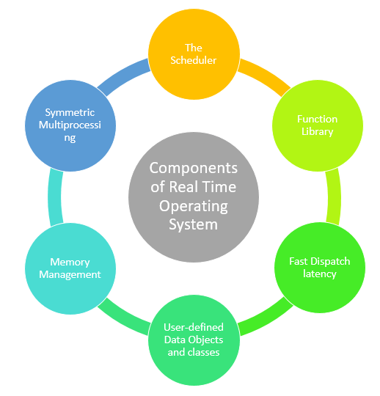
Components of RTOS
The Scheduler: This component of RTOS tells that in which order, the tasks can be executed which is generally based on the priority.
Symmetric Multiprocessing (SMP): It is a number of multiple different tasks that can be handled by the RTOS so that parallel processing can be done.
Function Library: It is an important element of RTOS that acts as an interface that helps you to connect kernel and application code. This application allows you to send the requests to the Kernel using a function library so that the application can give the desired results.

Slide 40
Components of RTOS
Memory Management: this element is needed in the system to allocate memory to every program, which is the most important element of the RTOS.
Fast dispatch latency: It is an interval between the termination of the task that can be identified by the OS and the actual time taken by the thread, which is in the ready queue, that has started processing.
User-defined data objects and classes: RTOS system makes use of programming languages like C or C++, which should be organized according to their operation.

Slide 41
Types of RTOS
Hard Real Time :
In Hard RTOS, the deadline is handled very strictly which means that given task must start executing on specified scheduled time, and must be completed within the assigned time duration.
Example: Medical critical care system, Aircraft systems, etc.
Firm Real time:
These type of RTOS also need to follow the deadlines. However, missing a deadline may not have big impact but could cause undesired affects, like a huge reduction in quality of a product.
Example: Various types of Multimedia applications.

Slide 42
Types of RTOS
Soft Real Time:
Soft Real time RTOS, accepts some delays by the Operating system. In this type of RTOS, there is a deadline assigned for a specific job, but a delay for a small amount of time is acceptable. So, deadlines are handled softly by this type of RTOS.
Example: Online Transaction system and Livestock price quotation System.

Slide 43
Session – January 26

Slide 44
Have you already prepared the Components for this semester?

Slide 45
Deadline & Predictability in RTOS
Any operating system deals with many different tasks, some of which are critical and must be executed immediately, for example with real-time applications. Other tasks may be lower-priority, and there are also cases when non-performance or even late performance of a high-priority task can be crucial.
A general-purpose operating system, is able to execute both critical and noncritical tasks according to the prioritization set by the developer. The main problem is that what a GPOS is able to do in theory, may not translate into practice. For example, a GPOS may switch from a critical task to another operation, completing the critical task only when the opportunity arises.
So how can you get a guarantee that a high-priority task will be executed in due time without any delays? By using a real-time operating system or RTOS. This is a type of OS that ensures the execution of tasks takes place within the specified time frame (Deadline and Predictability).

Slide 46
Deadline & Predictability in RTOS
By applying limitations to the execution time, an RTOS allows for running real-time applications that need an immediate response. This type of response is normally measured in milliseconds or even microseconds.
A real-time operating system provides a deterministic approach that excludes anything that is random from the sequence of operations performed on a system. In other words, the system behaves in a predictable way.
Provided that the algorithms are developed and implemented correctly, an RTOS ensures proper resource management so that a task is executed with exact timing. The timing behavior of an RTOS is considered deterministic.

Slide 47
typical parameters of a real-time task
Task – A set of related tasks that are jointly able to provide some system functionality.
Job – A job is a small piece of work that can be assigned to a processor, and that may or may not require resources.
Release time of a job – It's a time of a job at which job becomes ready for execution.
Execution time of a job: It is time taken by job to finish its execution.
Processors: They are also known as active resources. They are important for the execution of a job.
Response time of a job: It is a length of time from the release time of a job when the instant finishes.
Absolute deadline vs. relative deadline: If a task starts at time t0 and the corresponding deadline to finish this task (regarding time 0) is t0+d then the absolute deadline is t0+d but the relative deadline is just d.

Slide 48
typical parameters of a real-time task
The system is subjected to real time, i.e. response should be guaranteed within a specified timing constraint or system should meet the specified deadline. For example flight control system, real-time monitors etc.
There are two types of tasks in real-time systems:
Periodic tasks
Dynamic tasks
Periodic Tasks: In periodic task, jobs are released at regular intervals. A periodic task is one which repeats itself after a fixed time interval. For example: Consider the task Ti with period = 5 and execution time = 3. Phase is not given so, assume the release time of the first job as zero. So the job of this task is first released at t = 0 then it executes for 3 and then next job is released at t = 5 which executes for another 3 and then next job is released at t = 10. So jobs are released at t = 5k where k = 0, 1, . . ., n

Slide 49
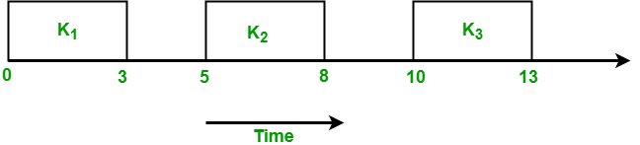
typical parameters of a real-time task
Dynamic Tasks: It is a sequential program that is invoked by the occurrence of an event. An event may be generated by the processes external to the system or by processes internal to the system. Dynamically arriving tasks can be categorized on their criticality and knowledge about their occurrence times:
Aperiodic Tasks: In this type of task, jobs are released at arbitrary time intervals i.e. randomly. Aperiodic tasks have soft deadlines or no deadlines.
Sporadic Tasks: They are similar to aperiodic tasks i.e. they repeat at random instances. The only difference is that sporadic tasks have hard deadlines.

Slide 50
jitter with respect to real-time operating systems
Sometimes actual release time of a job is not known. Only know that ri is in a range [ ri-, ri+ ]. This range is known as release time jitter. Here ri– is how early a job can be released and ri+ is how late a job can be released.
Only range [ ei-, ei+ ] of the execution time of a job is known. Here ei– is the minimum amount of time required by a job to complete its execution and ei+ the maximum amount of time required by a job to complete its execution.

Slide 51
latency with respect to real-time operating systems
Realtime applications require a predictable response time to external events, such as device interrupts. A typical real-time application involves:
An interrupt-generating device
An interrupt service routine that collects data from the device
User-level code that processes the collected data
Two types of latency are described in the following sections:
Interrupt service routine (ISR) latency
Process dispatch latency (PDL).

Slide 52
latency with respect to real-time operating systems
A system's interrupt service routine (ISR) latency is the elapsed time from when an interrupt occurs until execution of the first instruction in the interrupt service routine. The most important factor affecting this latency is the relative interrupt priority level (IPL) at which the ISR executes. When there are other ISRs of equal or greater interrupt priority level running at the time that the real-time device interrupts, the real-time device ISR is blocked from running until the current ISR is finished.
There could be multiple ISRs waiting to execute that have an equal or higher IPL at the time of the real-time interrupt, and all will hold off the real-time ISR until they complete. In addition, once the real-time ISR is running, it can be pre-empted or held off by one or more devices of higher IPL, and the real-time ISR will be delayed by the collective duration of these ISRs. Thus, it is important to know the relative IPLs of all the devices that could potentially interrupt during critical real-time processing, including system-provided devices such as a network driver or disk driver.

Slide 53
latency with respect to real-time operating systems
Process Dispatch Latency (PDL) is the time it takes from when an interrupt occurs until a process that was blocked waiting on the interrupt executes. Process dispatch latency includes:
ISR latency
ISR execution time
Time required to return from the ISR
Time required for the context switch back to the process-level code which is waiting on the interrupt
There are many more factors that can potentially increase the process dispatch latency of a real-time application. Any process that is currently executing code that holds a simple lock, is funneled to the master process, or has its IPL raised, will not be Preemptable by the real-time process and thus will hold off the real-time process from running

Slide 54
Task priority and time slicing in RTOS
Except for the guaranteed timing, an RTOS ensures task switching at the interval of every quantum. Tasks get interrupted and pre-empt each other according to the prioritization set by a developer. This is called pre-emptive scheduling.
Scheduling is an important procedure for an OS performance which manages the waitlist of tasks and determines the event sequence in accordance with the predefined priorities.
In RTOS scheduling, which is pre-emptive, any process can be interrupted by a high-priority task whenever it is assigned. Thus critical tasks will always pre-empt low-priority tasks.
The opposite of pre-emptive scheduling is non-pre-emptive or cooperative scheduling. An RTOS with a cooperative scheduler was the early version of a real-time operating system and it didn’t allow interrupting and switching to another task until one of them is completed or put in a waiting state.

Slide 55
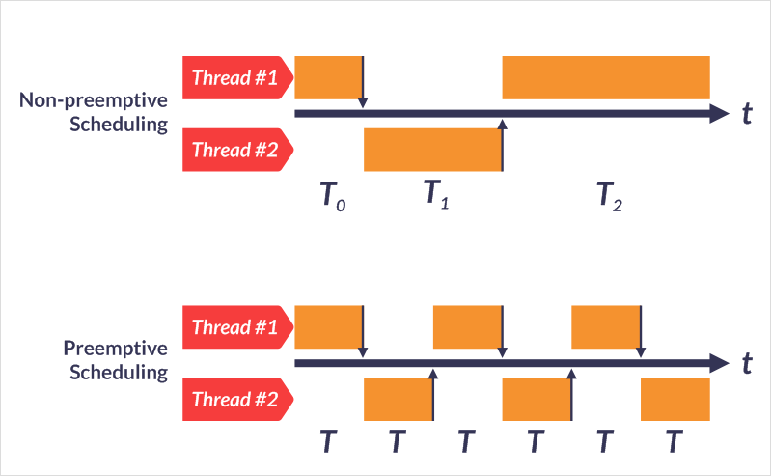
Task priority and time slicing in RTOS
In pre-emptive scheduling, tasks switch in equal time periods while in non-pre-emptive scheduling, there is no strict timing in task switching.

Slide 56
Task priority and time slicing in RTOS
A task can surrender the processor synchronously or asynchronously. To surrender control synchronously, the task should make some system call, in essence telling the OS that the task is waiting for something. If the OS knows the current task is just waiting, it can schedule some other task to do some real work, i.e., context switch . Calling the OS to wait on something is commonly called blocking, and it should be the goal of every task to do whatever has to be done as quickly as possible, then block.
Alternatively, if a task is not written for blocking, some other mechanism is needed to cause the context switch to occur. Interrupts cause an asynchronous break in the currently running code. This asynchronous break can result in the current task being pre-empted by some other higher priority task.
An interrupt handler written for an RTOS is usually wrapped with RTOS-specific code at the beginning and end.

Slide 57
Task priority and time slicing in RTOS
The code within the system call knows that if it is in an interrupt handler, it should not call the scheduler, as it normally would, but rather depend on that call happening when the interrupt handler exits. When the interrupt handler has finished, it invokes the scheduler, and, if a higher priority task is now ready to run, the switch is performed. The interrupt handler returns, but to a different task, i.e., context switch.
What if there is no system call in the interrupt handler that causes this context switch? If multiple tasks are configured with the same priority and all of the tasks refuse to block, a simple tick-driven time-slicing system can still keep the system moving.
Time-slicing by the RTOS is the ability to have multiple tasks with the same priority be given a slice of the CPU’s time. If your system has three tasks (all of equal priority) that all want to own the processor, the RTOSs ability to time-slice allows each task to receive some fixed number of system ticks of runtime. When the tick count is reached (a time slice), then the scheduler automatically changes context to the next task of the same priority. This approach is commonly called round-robin time-slicing.

Slide 58
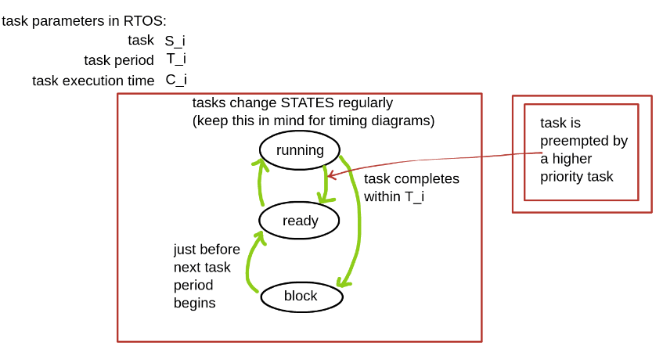
Task priority and time slicing in RTOS

Slide 59
RTOS “tick” and the trade-off between RTOS responsiveness and power consumption
Most real-time systems are based on clock period known as ‘tick’ and it's usually quite larger than CPU clock period.
Tick is also known as “time slice” or “quantum”.
There is a trade-off , if a tick is too short , then a scheduler may be too busy and the system will consume more power , on the other hand if the tick is too long , then the system will be less responsive to events or context switches.
Tick is often around 10 msec(100Hz).

Slide 60
the idle task and its practical implications
Idle task is automatically created when the scheduler starts to ensure there is always at least one task that is able to run. It is created at the lowest possible priority to ensure it does not use any CPU time if there are higher priority application tasks in the ready state.
However, when no tasks are available for the CPU then this task will run. When a task is deleted, the memory used by it will not be free immediately. This will be done in the idle task. Also in the idle-task, interrupts are switched off and on again.
The idle task cannot block – but it can put the CPU into sleep mode. The chosen sleep mode has to be such that the timer keeps running, and the tick interrupt will wake the processor. This has the effect of the idle task only ever performing one loop – preventing it from entering any critical sections and wasting power.
If you create a task that never blocks and has a priority higher than the idle task the idle task will never run.

Slide 61
scheduler overhead
Scheduler overhead is another concept that should be considered a little different from context switch that we discussed before.
Context switch means in your process one thread would enter in a wait/sleep state and other would enter in run state i.e. start executing. This does means storing the current state of thread that enters wait state and retrieving the other threads current state in order to start execution of the same from the point where it entered wait state.
On the other hand, Scheduling overhead means once threads enter into runnable state (ready to execute), OS would reschedule it to one of the processor along with resources it might need.

Slide 62
scheduling algorithms
Because pre-emption opens up the possibility that more than one service might be ready to run, and there are generally fewer CPU resources than services ready to run, a dispatch decision must be made. One of the simplest dispatch policies is: to give the CPU to the service assigned highest priority. These assigned priorities are never changed; they are fixed.
To decide how to assign priorities, two common real-time policies are to assign highest priority to the service with the shortest release period (highest request frequency), which is known as RM (Rate Monotonic), and to assign the highest priority to the services with the shortest relative deadline, which is known as DM (Deadline Monotonic). Note that RM is identical to DM when the release period equals the deadline.
However, one major drawback is that fixed priorities do not guarantee maximum use of the CPU.

Slide 63
scheduling algorithms
To attempt full usage of CPU resources and prove that services can meet deadlines, you are forced to consider pre-emptive dynamic-priority policies. One of the dynamic policies has been shown to have the capability to fully use CPU and guarantee deadlines, assuming service execution times and request intervals are deterministic or bounded is Earliest Deadline First (EDF).
By comparison, in EDF, any time a new service request arrives (indicated by an interrupt asynchronous), the EDF scheduling policy adjusts all priorities so that the service with the earliest absolute/ relative deadline is given highest priority. Ignoring the overhead of determining which service has the earliest impending deadline and ignoring overhead of priority reassignment, EDF can be shown to provide full use of the CPU where possible

Slide 64
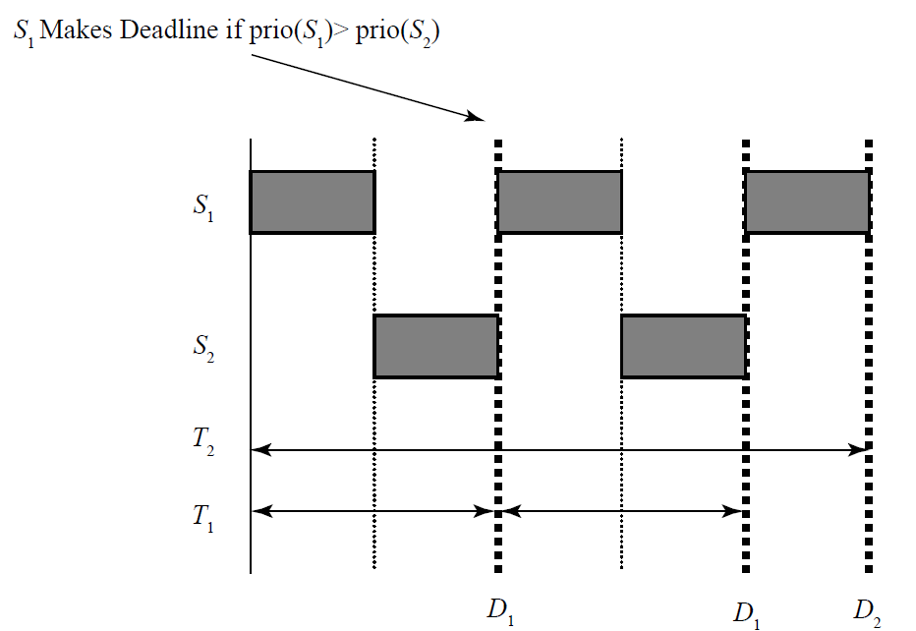
scheduling algorithms
To understand RM policy we give an example with two services follows: Given services S1 and S2 with release periods T1 and T2, execution times C1 and C2, and release periods T2 > T1, take, for example, T1 = 2, T2 = 5, C1 = 1, C2 = 2, and then if prio(S1)> prio(S2) (that can be enforced by RM policy), note the following Figure will be happening. (Whenever we are talking about making or missing deadlines we mean absolute deadlines which can be considered as release period for each task regarding time 0).

Slide 65
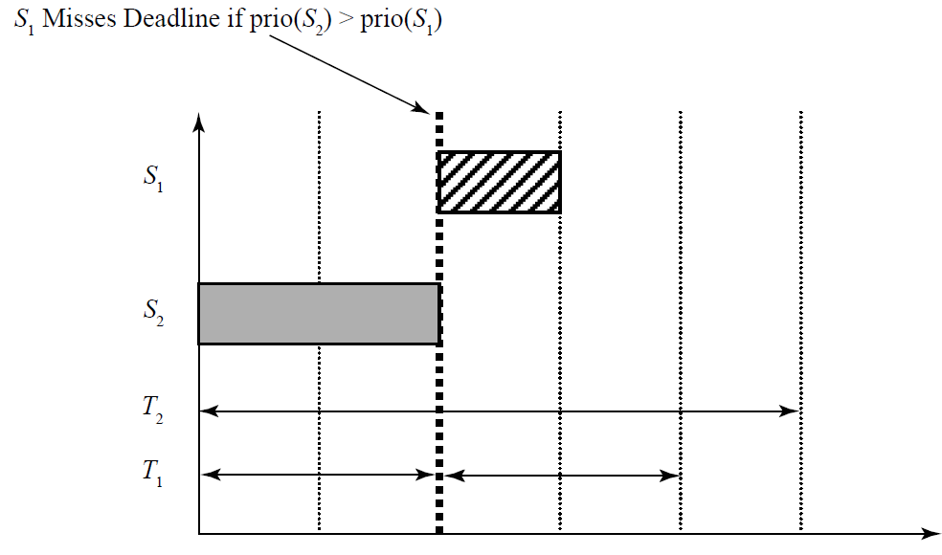
scheduling algorithms
In this two-service example, if we use an RM anti-policy then we have to consider prio(S2) > prio(S1), then the set of services would not be feasible. By feasible, we mean that the proposed set of services can be scheduled by a specific policy giving a known amount of CPU resource without missed deadline. Note the following Figure.

Slide 66
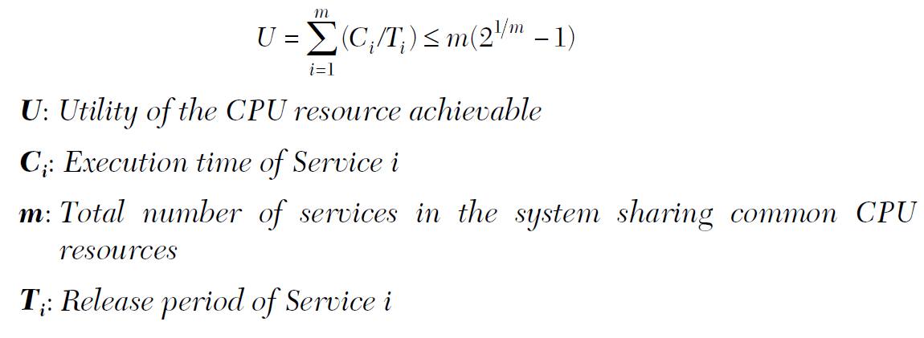
scheduling algorithms
The conclusion that can be drawn is that for a two-service system, the RM policy is optimal, whereas the only alternative is not optimal because the alternative policy fails when a workable schedule does exist! The same argument can be posed for a three-service system, a four-service system, and finally an N-service system. In all cases, it can be shown that the RM policy is optimal.
Given that the RM priority assignment policy is optimal, we now want to determine whether a proposed set of services is feasible. One such test is the RM LUB: Liu and Layland proposed this simple feasibility test they call the RM Least Upper Bound (RM LUB). The test says: “The system is feasible if the actual utilization of CPU is bonded by the RM LUB” as

Slide 67
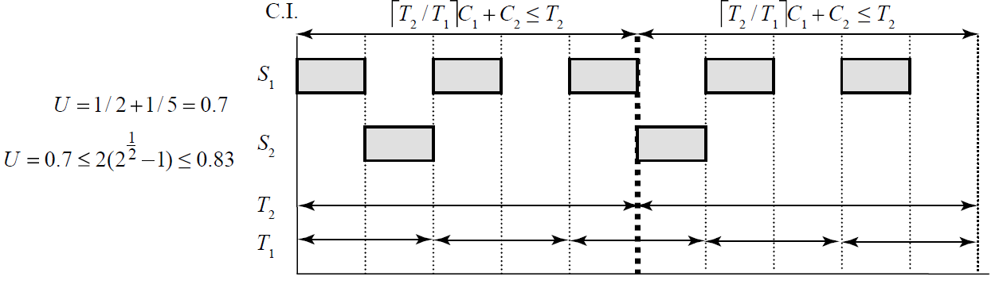
scheduling algorithms
For a system, can all Cs fi t in the largest T over LCM (Least Common Multiple) time? Given Services S1, S2 with periods T1 and T2 and C1 and C2, assume T2 > T1, for example, T1 = 2, T2 = 5, C1 = 1, C2 = 1; and then if prio(S1) > prio(S2) (based on RM), you can see that they can by inspecting a timing diagram, as shown in the following Figure.
The actual utilization of 70% is lower than the RM LUB of 83.3%, and the system is feasible by inspection. So, the RM LUB appears to correctly predict feasibility for this case.

Slide 68
scheduling algorithms
An alternative to RM or DM is the dynamic-priority policies derived from the deadline-driven dynamic-priority approach, first presented by Liu and Layland. Priority pre-emptive dynamic-priority systems can be thought of as a more complex class of priority pre-emptive where priorities are adjusted by the scheduler every time a new service is released and ready to run.
The policy Liu and Layland specified in their paper later became known as an EDF (Earliest absolute/relative Deadline First) dynamic-priority policy. The policy is called EDF because the scheduler gives highest priority to the service that has the soonest absolute/ relative deadline whenever a dispatch decision is made.

Slide 69
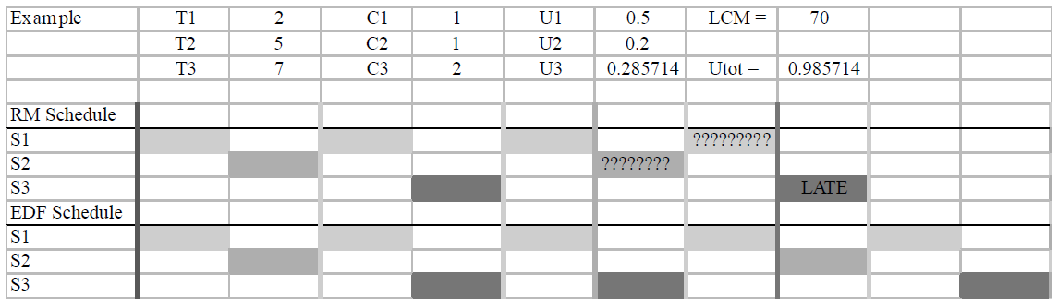
scheduling algorithms
The following Figure shows a scenario where the fixed-priority RM policy fails, and EDF succeeds.

Slide 70
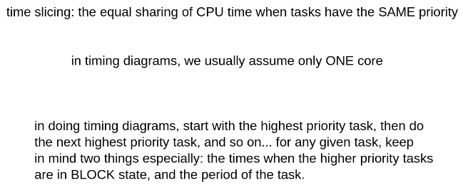
scheduling algorithms
The final tips to do timing diagram exercises:

Slide 71
scheduling algorithms
More Exercises:
Services S1, S2 with periods T1 and T2 and C1 and C2; and assuming T2 = T1, for example, T1 = 2, T2 = 5, C1 = 1, C2 = 2; then is prio(S1) > prio(S2) based on RM policy feasible? Support your answer by both RM LUB as well as Timing Diagram.
try EDF on our simple example: T1=2, T2=3, T3=6; C1=2, C2=3, C3=6; (literally thinking like a schedule)
RM: T1=4, T2=5, T3=10; C1=1, C2=2, C3=3;
RM: T1=3, T2=8, T3=12; C1=2, C2=2, C3=3;
RM: T1=5, T2=10, T3=15; C1=2, C2=4, C3=5;

Slide 72
Session – February 2

Slide 73
Have you already prepared the Components for this semester?

Slide 74
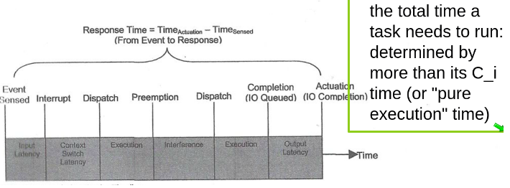
More on Task Execution Time in RTOS
The following Figure illustrates an example of real-time service implementation time-line. In this example, the service is responding to a sensor and operating an actuator accordingly. As you observe, the total time is longer than the dedicate execution time for the task. In fact, input/ output latencies, context switch latency, any possible pre-emption by higher priority tasks have also affected the time-line.
Also, recall everything in RTOS theory is per core!

Slide 75
Game of Life: An illustrative Project of Pthreads Implementation in RTOS
The Game of life is dependent on a cell and its neighbors and the game is played in terms of generation. For a cell to go to next generation which we call alive for a second or next generation it has to see for its neighbors if there is no sufficient number of neighbors or if it has excess of neighbors surrounding it, we call the cell as a dead and it won’t be present in the next generation of the game. In the game thus we can have a cell alive which would be denoted as logical ‘1’ or we can have the cell dead denoted by logical ‘0’.
The rules that decide if the cell is alive or dead are governed by the 3 rules as mentioned:
If a cell has less than 2 neighbors ,i.e., just one single neighbor or no neighbor it can die of isolation. It is like having a lack of resources to survive.
A cell can be born or live for the next generation of the game if and only if it has exactly 3 neighbors surrounding it.
If a cell has more than 4 neighbors, then the cell will be bound to die in its next generation due to overcrowding

Slide 76
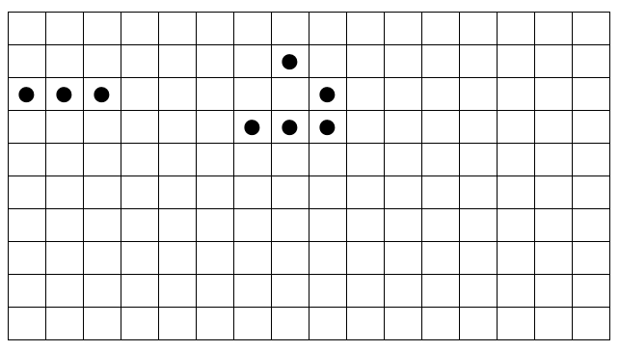
Game of Life: An illustrative Project of Pthreads Implementation in RTOS
Let’s illustrate this concept using a simple example of a glider as John Conway the inventor of this game called it.
Consider we have a matrix of 10x16 and the initial or starting pattern as shown below:

Slide 77
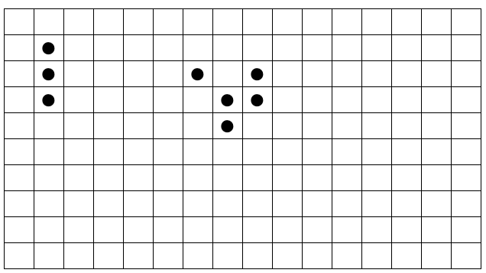
Game of Life: An illustrative Project of Pthreads Implementation in RTOS
Second Generation of the Game: :

Slide 78
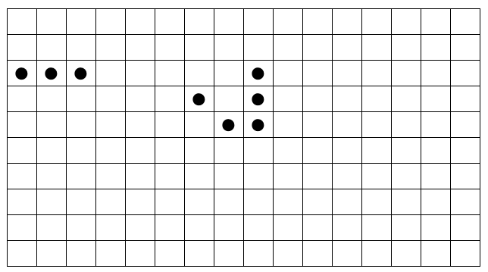
Game of Life: An illustrative Project of Pthreads Implementation in RTOS
Third Generation of the Game:

Slide 79
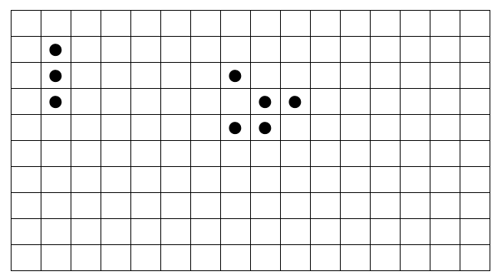
Game of Life: An illustrative Project of Pthreads Implementation in RTOS
Fourth Generation of the Game:

Slide 80
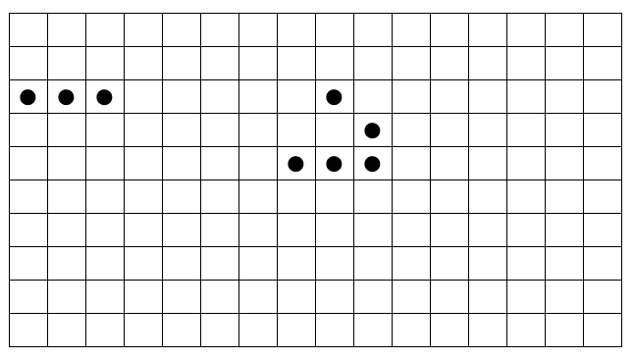
Game of Life: An illustrative Project of Pthreads Implementation in RTOS
Fifth Generation of the Game:

Slide 81
Game of Life: An illustrative Project of Pthreads Implementation in RTOS
As you can see in the example in the fifth generation, we get back to initial started pattern and also the pattern the glider pattern on the right side is just shifted and it will be seen like crawling after each of the 5 generations of the game and the simple 3 horizontal pattern keeps on oscillating in alternative pattern thus called as the oscillatory pattern.
Watch the venerable You-tube link with music:
https://www.youtube.com/watch?v=C2vgICfQawE

Slide 82
Lab #1: Game of Life Project
Game of Life is an example of a real-time operating application and in this lab and based on the given theoretical description of the Game of Life project, you can find several pthread-based C programs that you need to complete and implement this game.
I suggest the students to read the following article for getting more into Conway's Game of Life:
https://web.stanford.edu/class/sts145/Library/life.pdf

Slide 83
Module II.
Develop practical RTOS applications on an actual embedded target

Slide 84
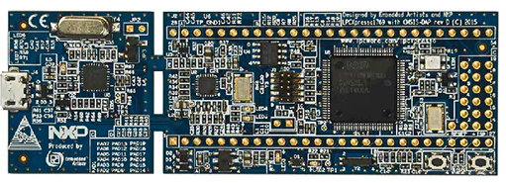
NXP LPCXpresso
Pioneered by NXP® and Embedded Artists, the LPCXpresso™ development platform includes low-cost LPCXpresso target boards to get you up and running quickly. Designed for simple, rapid prototyping and evaluation, LPCXpresso™ development boards work with the LPCXpresso IDE and other industry leading partner toolchains. LPCXpresso™ is an end-to-end solution enabling embedded engineers to develop their applications from initial evaluation to final production.
This LPCXpresso™ board is populated with the LPC1769 to demonstrate and enable evaluate of the features of the LPC1700 product series. The board includes an on-board, CMSIS-DAP compatible debug probe as well as a connector for use with 3rd party debug probes.

Slide 85
LPC1769: General Description
The LPC1769 board with NXP's ARM Cortex-M3 microcontroller has been designed to make it as easy as possible to get started with Cortex-M3.
The included debug interface is CMSIS-DAP compatible, meaning that it is supported by many development environments, including (but not limited to) MCUXpresso IDE, uVision from Keil/ARM, Embedded Workbench from IAR, etc.
The CMSIS-DAP debugger can be disabled with a jumper, allowing an external debugger to be connected (via a standard 10 pos Cortex debug connector). The debug side can be removed in a simple way (snap/break off), but note that it is not possible to connect the two parts again. After breaking off the debug side, we recommend using LPC-Link2 as the debug solution.
The LPC1769 processor provides 64 kB SRAM, 512 kB Flash, 4xUART, 3xI2C, SPI, 2xSSP, 2xCAN, PWM, USB 2.0 Device/Host/OTG, RTC, Ethernet, I2S, etc. at a clock speed up to 120 MHz.

Slide 86
LPC1769: Features
120MHz ARM Cortex-M3 MCU with 512 kB flash and 64 kB SRAM
Full-Speed (12 Mb/s) USB 2.0 with on-chip PHY with support for USB device, host and OTG
Ethernet support (with dedicated DMA for high speed memory transfers)
Four UARTs, Two CAN 2.0 ports, Three SPI buses, Three I2C buses, and I2S for audio
12-bit ADC and 10-bit DAC
Four HW timers, including one motor control PWM timer with support for three-phase motor control
Quadrature encoder interface
Real-Time Clock (RTC) with a separate power domain to keep track of the time even when the board is powered down

Slide 87
LPC1769: Features
Dimensions: 35 x 105 mm
Power: 3.3V external powering, or 4.5-5.5V external powering, or from USB via CMSIS-DAP debug interface
Connectors: All relevant LPC1769 pins available on expansion connector (2x27 pin rows, 100 mil pitch, 900 mil between rows)
Embedded debug interface that is CMSIS-DAP compatible
Embedded debugger can be disabled to allow external debuggers to connect to the 10 pos Cortex debug connector
RGB-LED
ISP-enable push-button
Reset push-button

Slide 88
LPC1769:Target Applications
eMetering
Lighting
Industrial networking
Alarm systems
White goods
Motor control

Slide 89
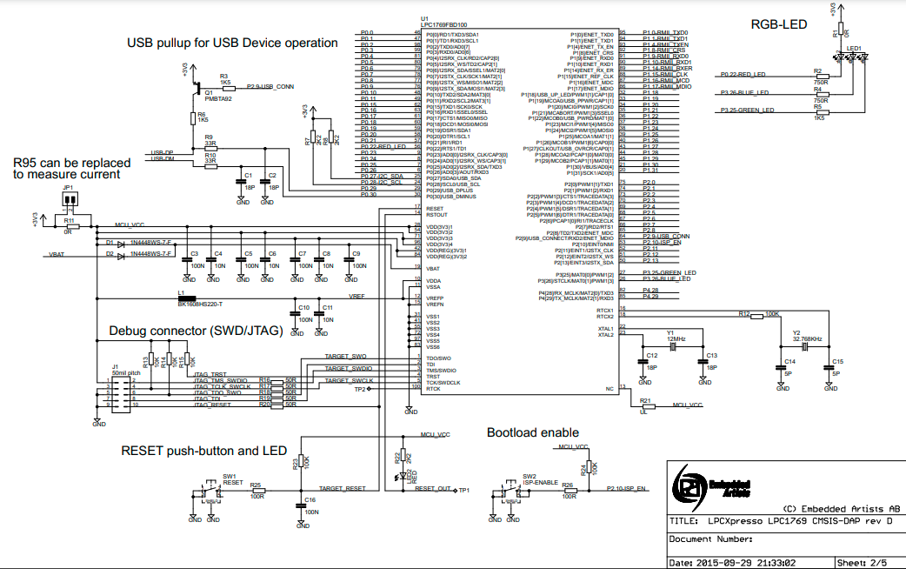
LPC1769: Schematics

Slide 90
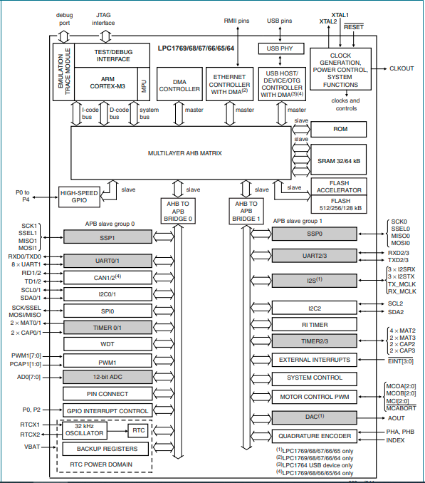
LPC1769 Block Diagram

Slide 91
Pinning Information
P0[0] to P0[31] I/O Port 0:
Port 0 is a 32-bit I/O port with individual direction controls for each bit. The operation of port 0 pins depends upon the pin function selected via the pin connect block. Pins 12, 13, 14, and 31 of this port are not available.
P1[0] to P1[31] I/O Port 1:
Port 1 is a 32-bit I/O port with individual direction controls for each bit. The operation of port 1 pins depends upon the pin function selected via the pin connect block. Pins 2, 3, 5, 6, 7, 11, 12, and 13 of this port are not available.
P2[0] to P2[31] I/O Port 2:
Port 2 is a 32-bit I/O port with individual direction controls for each bit. The operation of port 2 pins depends upon the pin function selected via the pin connect block. Pins 14 through 31 of this port are not available.
P3[0] to P3[31] I/O Port 3:
Port 3 is a 32-bit I/O port with individual direction controls for each bit. The operation of port 3 pins depends upon the pin function selected via the pin connect block. Pins 0 through 24, and 27 through 31 of this port are not available.

Slide 92
Pinning Information
P4[0] to P4[31] I/O Port 4:
Port 4 is a 32-bit I/O port with individual direction controls for each bit. The operation of port 4 pins depends upon the pin function selected via the pin connect block. Pins 0 through 27, 30, and 31 of this port are not available
TDO/SWO 1[1]:
O TDO — Test Data out for JTAG interface.
O SWO — Serial wire trace output.
TDI 2[1] :
I TDI — Test Data in for JTAG interface.
TMS/SWDIO 3[1]:
I TMS — Test Mode Select for JTAG interface.
I/O SWDIO — Serial wire debug data input/output.
TRST 4[1]:
I TRST — Test Reset for JTAG interface.

Slide 93
Pinning Information
TCK/SWDCLK 5[1]:
I TCK — Test Clock for JTAG interface.
I SWDCLK — Serial wire clock.
RTCK 100[1]:
I/O RTCK — JTAG interface control signal.
RSTOUT 14:
O RSTOUT — This is a 3.3 V pin. LOW on this pin indicates the microcontroller being in Reset state.
RESET 17[7]:
I External reset input: A LOW on this pin resets the device, causing I/O ports and peripherals to take on their default states, and processor execution to begin at address 0. TTL with hysteresis, 5 V tolerant.
XTAL1 22[8][9]:
I Input to the oscillator circuit and internal clock generator circuits.
XTAL2 23[8][9]:
O Output from the oscillator amplifier.

Slide 94
Pinning Information
RTCX1 16[8]:
I Input to the RTC oscillator circuit.
RTCX2 18[8]:
O Output from the RTC oscillator circuit.
VSS 31, 41, 55, 72, 97, 83[8]:
I ground: 0 V reference.
VSSA 11[8]:
I analog ground: 0 V reference. This should nominally be the same voltage as VSS, but should be isolated to minimize noise and error.
VDD(3V3) 28, 54, 71, 96[8]:
I 3.3 V supply voltage: This is the power supply voltage for the I/O ports.
VDD(REG)(3V3) 42, 84[8]:
I 3.3 V voltage regulator supply voltage: This is the supply voltage for the on-chip voltage regulator only.

Slide 95
Pinning Information
VDDA 10[8]:
I analog 3.3 V pad supply voltage: This should be nominally the same voltage as VDD(3V3) but should be isolated to minimize noise and error. This voltage is used to power the ADC and DAC. This pin should be tied to 3.3 V if the ADC and DAC are not used.
VREFP 12[8]:
I ADC positive reference voltage: This should be nominally the same voltage as VDDA but should be isolated to minimize noise and error. Level on this pin is used as a reference for ADC and DAC. This pin should be tied to 3.3 V if the ADC and DAC are not used.
VREFN 15:
I ADC negative reference voltage: This should be nominally the same voltage as VSS but should be isolated to minimize noise and error. Level on this pin is used as a reference for ADC and DAC.
VBAT 19[8]:
I RTC pin power supply: 3.3 V on this pin supplies the power to the RTC peripheral.
n.c. 13:
not connected

Slide 96
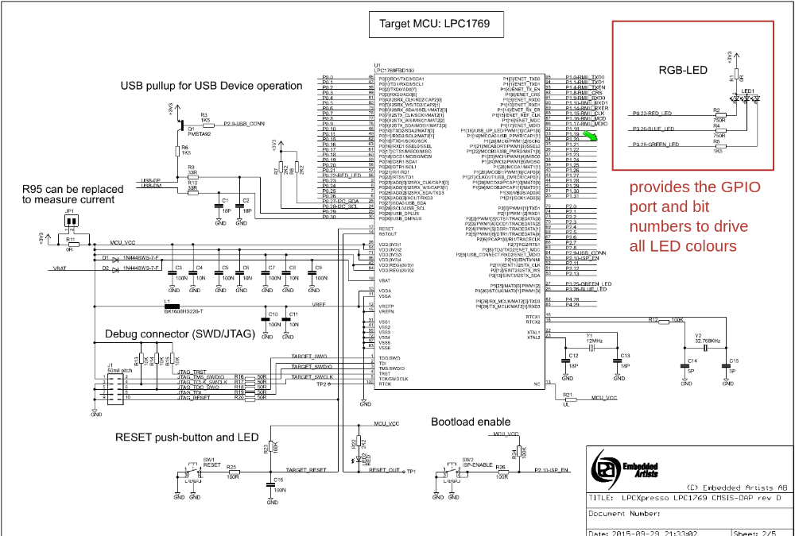
LPC1769 - LED Drivers

Slide 97
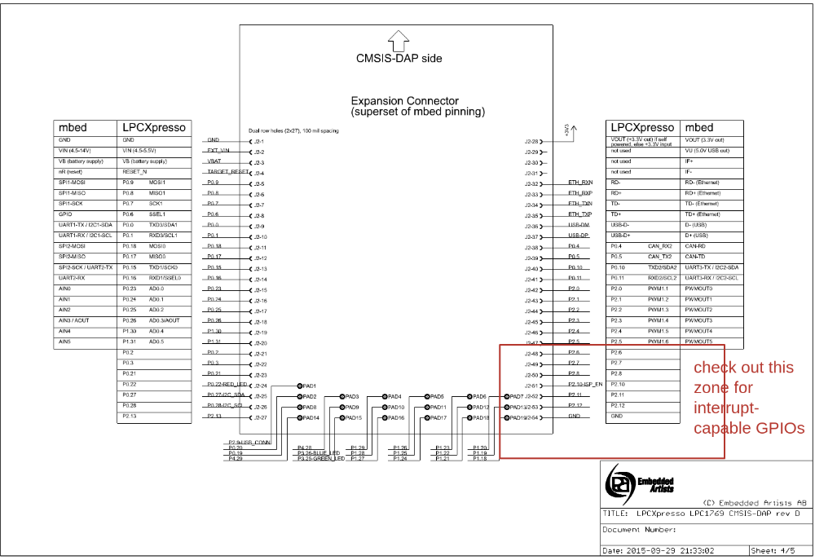
LPC1769 – External Interrupts

Slide 98
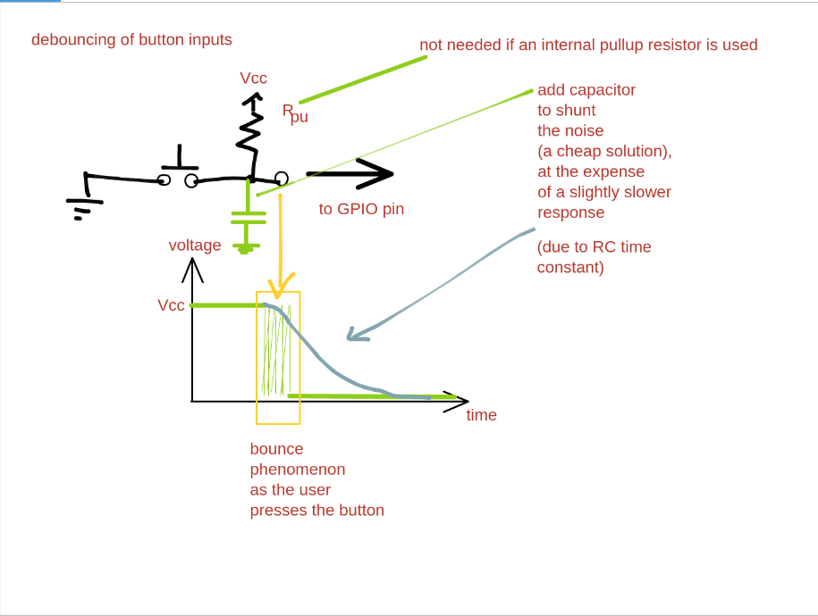
LPC1769 – External Interrupts

Slide 99

MCUXpresso Integrated Development Environment (IDE)
The MCUXpresso IDE brings developers an easy-to-use Eclipse-based development environment for NXP MCUs based on ARM® Cortex®-M cores, including, among many others, the LPC series processors.
The MCUXpresso IDE offers advanced editing, compiling and debugging features with the addition of MCU-specific debugging views, code trace and profiling, multicore debugging, and integrated configuration tools.
The MCUXpresso IDE is available in full-featured free (code size unlimited) and affordable professional editions.

Slide 100
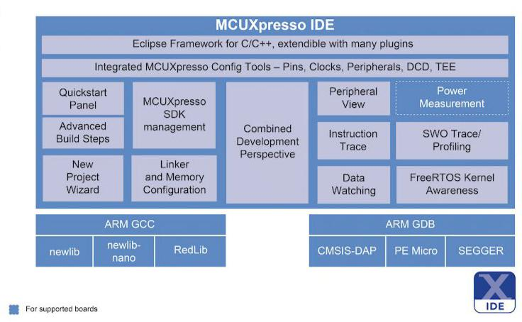
MCUXpresso Integrated Development Environment (IDE)

Slide 101
MCUXpresso Integrated Development Environment (IDE)
Some of the features of MCUXpresso Include:
Built-in SDK selection tool or drag and drop packages made with SDK builder
Integrated tool is including pins, clocks, peripherals, etc for boards
Integrated GUI Flash programming
Heap and Stack Usage Views to track heap and stack usage of bare metal projects
Support for FreeRTOS aware debugging
Highly extensible using widely available eclipse plug-ins

Slide 102
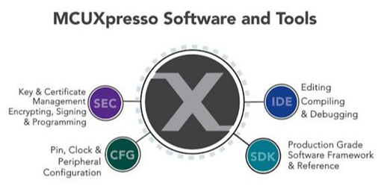
MCUXpresso Integrated Development Environment (IDE)
Available on the following host only:
Microsoft Windows (8/10) 64 bits only
Ubuntu Linux 16.04 or later 64 bit only
macOS 10.11 onwards
High resolution viewing capabilities for global variables, textual/graphical live variables

Slide 103
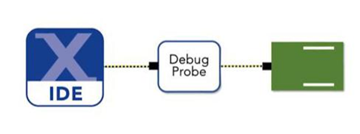
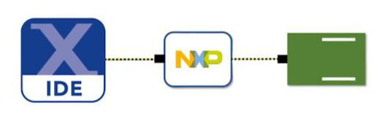
MCUXpresso Integrated Development Environment (IDE)
The main feature of MCUXpresso IDE is that it can be wired with the real time board as in dumping or burning the code programmed for a sensor or device directly on the LPC, freedom or any other supported board.
The MCUXpresso IDE debug connections support Freedom, Tower® system, LPCXpresso, i.e. MX RT, and your custom development boards with industry-leading open-source and commercial debug probes from NXP, P&E Micro®, and SEGGER®.

Slide 104

MCUXpresso Integrated Development Environment (IDE)
NXP MCUXpresso Config Tools helps you to configure and connect tools along with different SDK Available along with device configuration as shown below.

Slide 105

Installation of MCUXpresso IDE
Login into www.nxp.com and create an account in case you don't have one.
In the search type MCUXpresso IDE and download the file as required by the system. For the installation, you can download the file for Linux 18.04 LTS having .deb extension or for Windows having .exe extension.
If you are on Linux then in the terminal make the downloaded file executable using the following command: chmod a+x <filename.deb> and then run the executable using the sudo ./<filename.deb> (watch the video from youtu.be/d2ywTsPBNRY)
If you are on Windows just click the filename.exe and click next buttons….
When asked to accept the agreement use the tab key and then enter to select the option.
After the install the MCUXpresso IDE looks as shown:
The following materials about adding the template is based
on assumption you are on Windows

Slide 106
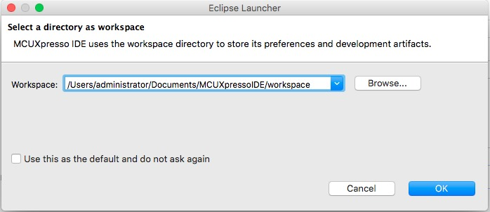
MCUXpresso IDE: Adding A Template Project
After getting your LPC1768 or LPC1769 Cortex-M3 Development Board, it is time to getting started with MCUXpresso IDE. After install, follow the steps below to create a new project for LPC1769. A sample project is created for our LPC1769 - ARM Cortex M3 Starter Kit And Development Board.
Step 1: When you start MCUXpresso, it will first ask for a path to create a workspace. A workspace is like a master directory with settings and can contain many individual projects, more like a general “Projects” folder. When prompted enter the path where you want to create your workspace:
You can choose any path, but we recommend to go with the default settings. Be aware that the IDE allows you to create several workspaces and to switch between them. In fact, we recommend to use this feature to separate projects in a logical order that fits your needs.

Slide 107
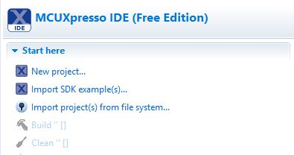
MCUXpresso IDE: Adding A Template Project
Step 2: In this step, we will create a new project that fits the requirements for the LPC1769. The IDE will launch right after installation. Now, click on the "New Project..." link in the "Quickstart" panel (bottom left view of the IDE):

Slide 108
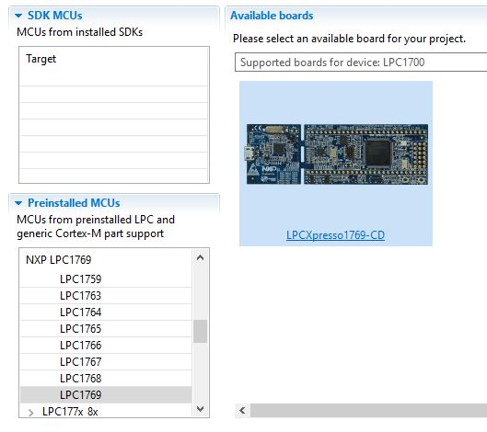
MCUXpresso IDE: Adding A Template Project
Step 3: The project wizard will open as shown below. Select the target MCU (LPC1769), the click Next:

Slide 109
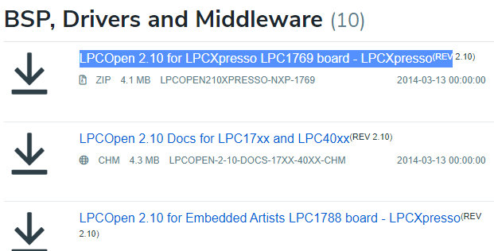
MCUXpresso IDE: Adding A Template Project
If you can not find LPC1769 directly then click on LPC1700 on the target list and LPC1769-CD with a web link will appear. Go to the link and scroll down and click to download “LPCOpen Software Development Platform (LPC17xx packages)”. Ensure you have downloaded “LPCOpen 2.10 for LPCXpresso LPC1769 board - LPCXpresso(REV 2.10)” as a zip file and save it in a folder of your option.
Now again get back to the Available boards screen mentioned in the previous slide but just click on the image of the board itself, and then click Next.

Slide 110
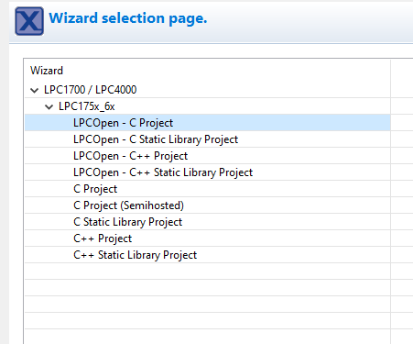
MCUXpresso IDE: Adding A Template Project
Step 4: Select “LPCOpen-C Project," the click Next.
Note: Our initial code examples are written in "C". If and when the need arises, you can always open a new project with the "C++" settings.

Slide 111
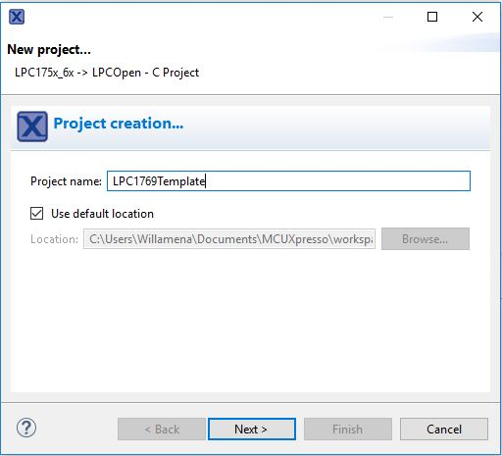
MCUXpresso IDE: Adding A Template Project
Step 5: Enter a suitable name for your project, then click Next. In this example, we chose "LCP1769Template" (use "LPC1768Template" for the LPC1768 board), and we recommend following this naming convention. In further slides to follow, we will copy the template code and modify it to suit the chosen application.

Slide 112
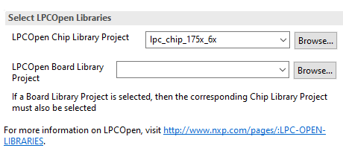
MCUXpresso IDE: Adding A Template Project
Step 6: In this step, we install the CMSIS (Cortex Microcontroller System Interface Standard) for the LPC1769. However, before you continue, assure that the CMSIS is not already installed.
If you see a reference to LPCOpen Chip and Board Library Project in the IDE's project window as shown below, you should skip to step 7.

Slide 113
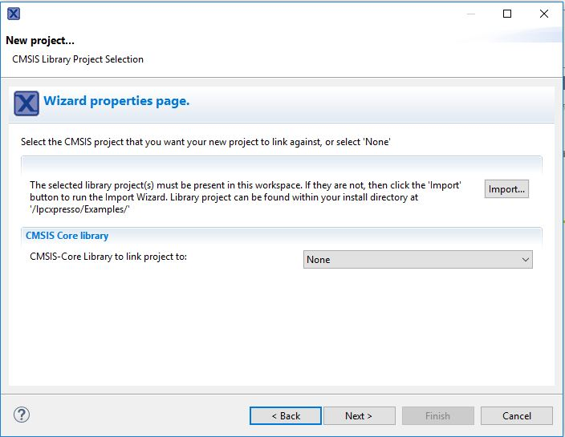
MCUXpresso IDE: Adding A Template Project
Otherwise in order to install the mentioned library, click on the Import button.
A new “Import…” window will appear. Click on “Browse” under “Project archive (zip)”. Then select the required zip file that you downloaded during step 3 and click Open.

Slide 114
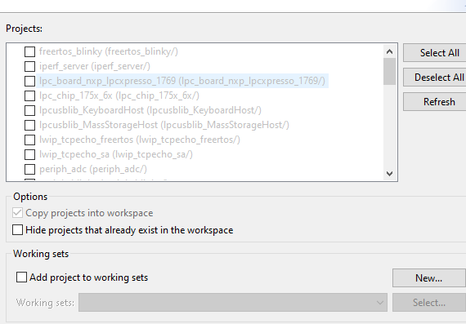
MCUXpresso IDE: Adding A Template Project
Click Next.
In the dialog below, ensure all existing projects are selected (Select All) and then click Finish.

Slide 115
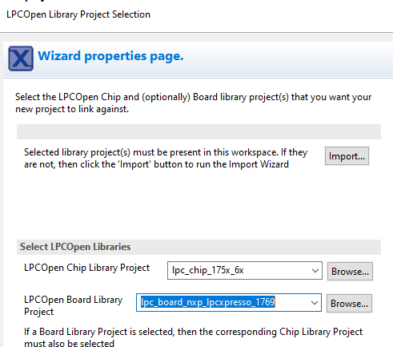
MCUXpresso IDE: Adding A Template Project
Step 7: Under “Select LPCOpen Libraries” select lpc_board_nxp_lpcxpresso_1769 for the LPCOpen Board Library Project and click Next.

Slide 116
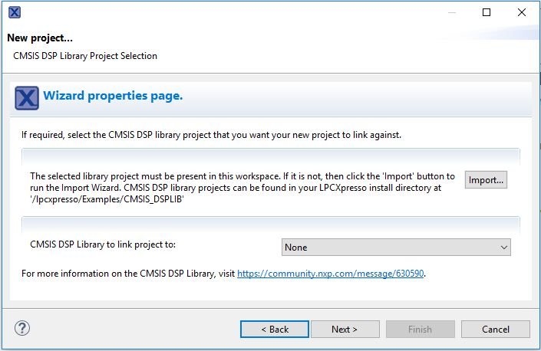
MCUXpresso IDE: Adding A Template Project
Step 8: In the next window, click Next again.

Slide 117

MCUXpresso IDE: Adding A Template Project
Step 9: In the dialog window as shown below, select the option "Create 'inc' directory and add to path," then click Finish.

Slide 118

MCUXpresso IDE: Adding A Template Project
Note: We will use the 'inc' folder to add header files supporting access to various interface components on the board, while we will usually use the ‘src’ folder to add c project programs
As of now, we have created a working core project, however, without any functionality.

Slide 119

MCUXpresso IDE: Adding A Template Project
Looking at the LPC1769Template.c file, which contains the main() function), there are a few "TODO" sections.

Slide 120

MCUXpresso IDE: Executing freertos_blinky project
As an example, you can start with execution of available famous project called freertos_blinky.
From the Project Explorer, click the freertos_blinky <Debug> and from Project menu click Build Project, as you can see CDT Build Console announces there is no error or warning. By building the project, in fact you are compiling it and an object file with the same name of the project and the extension of .axf is generated in the same project folder (here: freertos_blinky.axf).
Now we should load the file into the target board. Ensure you have connected the LPC1769 board to your host machine. Click the freertos_blinky <Debug> again and this time click on the GUI Flash Tool:
A dialog window will appear confirming the available probe to load your object file. Click OK.

Slide 121


MCUXpresso IDE: Executing freertos_blinky project
Under Target Operation, ensure Program (and not Erase) is chosen and the format to use for programming is axf and then click RUN.
You should receive a pop-up window telling the operation is successful and now observe the result on your board!

Slide 122
Session – February 16

Slide 123
MCUXpresso IDE: Alternative Way to Set up
Step 1: Click on File menu > Switch Workspace > Other
Step 2: Launch a new workspace
Step 3: From the Quickstart panel > Import projects from file system
Step 4: Browse for lpcopen zip in the Atchive box then click Next
Step 5: While Import project from file system page pops up, first Deselect All
Step 6: Now select only three files including FreeRTOS Blinky Project, LPC1769 Board Library, and LPC1769 Chip Library; and then click Finish.

Slide 124

MCUXpresso IDE: Alternative Way to Set up

Slide 125

MCUXpresso IDE: Alternative Way to Set up

Slide 126

MCUXpresso IDE: Alternative Way to Set up

Slide 127

Freertos_blinky Project Overview
Freertos_blinky project is a default project visible in the project explorer window whenever you set up an MCUXpresso workspace for LPC1769. The folder consists of several subfolders such as Project References, freertos, and example.

Slide 128

Freertos_blinky Project Overview
Project References includes two local references referring to the chip and board libraries.

Slide 129

Freertos_blinky Project Overview
Freertos itself consists of inc and src subfolders to keep the essential source codes and library header files for each freertos-based project.

Slide 130

Freertos_blinky Project Overview
example is going to keep your own C project (in src) and the required library files (in inc) that can be found in freertos subfolder. Concurrently it has freertos_blinky.c and FreeRTOSConfig.h files.

Slide 131
New Freertos Project
Step 1: Copy/ paste the whole freertos_blinky folder in the project explorer window with a new name
Step 2: Keep all the subfolders unchanged and just remove the existing c code from the example subfolder (i.e., freertos_blinky.c)
Step 3: Copy your own c code in the src of example subfolder instead; and add any additional required library header file in the inc of example subfolder if doesn’t already exist.
Step 4: Build and Run your own project now.

Slide 132

New Freertos Project

Slide 133
Assignment #2: Review RTOS before FreeRTOS Overview
Before we start FreeRTOS discussion in class, watch the video and prepare a report for each of the following part: (https://www.youtube.com/watch?v=WzKsMfn2sBE)
Scheduling in Multi-tasking Operating Systems
Multitasking Realtime Operating System
The RT in RTOS
Task States
A Typical Embedded System Application
Super Loop Solution
Scaling and Maintenance in Super Loop Solution
RTOS Alternative
Motor Control Task Structure
Task States in RTOS
Scaling and Maintenance in RTOS
FreeRTOS: Open Source Real Time Kernel
How FreeRTOS fits Microcontrollers
Is FreeRTOS Free?
FreeRTOS + Ecosystem
FreeRTOS Website: Not Needed

Slide 134
About Session on February 23
Reviewing Lab #1 & Assignment #2
Test #1: Part 1
Multiple-Choice Questions: All the materials before Session February 2
Test #1: Part 2
Subjective Questions: Task Time-Table Diagrams
Test #1: Part 3
Question & Answer in Class to All Students

Slide 135
Session – February 23

Slide 136
Lab #2: Activating Blue and Green LEDs
The board.c that ships with the LPC1769 LPCOpen C SDK are lacking in one important respect: it does not provide access to the Blue and Green on-board LEDs!
We will need the full RGB features of the onboard LEDs in order to perform some of our RTOS experiments. Therefore, this lab is about to modify the board.c library in your MCUXpresso LPC1769 project to allow us to access the other (green and blue) LEDs.
This is an opportunity to experience some vendor driver code and getting in there to make some modifications. You will need to acquaint yourselves somewhat with board.c.
Note that almost any project that you create for the LPC1769 in MCUXpresso, references the board and chip libraries that you imported with your FreeRTOS Blinky demo project. So any modifications you make to the board and chip libraries are "visible" to any project you build for the LPC1769 within the MCUXpresso IDE.
There are some macro definitions you will need to add (#define ...) and some changes to various functions, including: BoardLEDSet(), BoardLEDState(), etc. Use <CTRL><F> to track down all the functions in your library that will need modifications!

Slide 137
Lab #2: Activating Blue and Green LEDs on LPC1769 Board
Step 1: Compile and run freertos_blinky.c from the default freertos_blinky project folder and record the result from your board.
Step 2: Create a new project folder like freertos_blinky_new, add the new source code called New Blinky_LEDs.c to it. You can clone this source code from https://github.com/mikeshams/ESE3025/upload
Step 3: Add retarget.h to the new project folder. You can clone this library header file from the same GitHub link.
Step 4: Go to the lpc_board_nxp_lpcxpresso_1769 project folder available on the project explorer window and cut the original board.c in a safe place on your machine and replace it with the modified_board.c that you can clone it from the same GitHub link. (Do you need to rename this file as board.c?)
Step 5: Compile and run your New Blinky_LEDs.c and record the result from your board. Compare your result with that from step 1.

Slide 138
Lab #2: Activating Blue and Green LEDs on LPC1769 Board
Step 6: Compare the freertos_blinky.c with the New Blinky_LED.c. What code lines are added or
removed? Try to understand them by adding comments!
Step 7: Compare the original board.c with the modified board.c. What code lines are added or
removed? Try to understand them by adding comments!

Slide 139
Session – March 2

Slide 140
Understanding the FreeRTOS Distribution
FreeRTOS can be built with approximately twenty different compilers, and can run on more than thirty different processor architectures. Each supported combination of compiler and processor is considered to be a separate FreeRTOS port.
FreeRTOS can be thought of as a library that provides multi-tasking capabilities to what would otherwise be a bare metal application.
FreeRTOS is supplied as a set of C source files. Some of the source files are common to all ports, while others are specific to a port. Build the source files as part of your project to make the FreeRTOS API available to your application. To make this easy for you, each official FreeRTOS port is provided with a demo application. The demo application is pre-configured to build the correct source files, and include the correct header files.
Demo applications should build ‘out of the box’, although some demos are older than others, and sometimes a change in the build tools made since the demo was released can cause an issue.

Slide 141
Understanding the FreeRTOS Distribution
FreeRTOS is configured by a header file called FreeRTOSConfig.h.
FreeRTOSConfig.h is used to tailor FreeRTOS for use in a specific application. For example, FreeRTOSConfig.h contains constants such as configUSE_PREEMPTION, the setting of which defines whether the co-operative or pre-emptive scheduling algorithm will be used. As FreeRTOSConfig.h contains application specific definitions, it should be located in a directory that is part of the application being built, not in a directory that contains the FreeRTOS source code.
A demo application is provided for every FreeRTOS port, and every demo application contains a FreeRTOSConfig.h file. It is therefore never necessary to create a FreeRTOSConfig.h file from scratch. Instead, it is recommended to start with, then adapt, the FreeRTOSConfig.h used by the demo application provided for the FreeRTOS port in use.
FreeRTOS is distributed in a single zip file. The zip file contains source code for all the FreeRTOS ports, and project files for all the FreeRTOS demo applications. It also contains a selection of FreeRTOS+ ecosystem components, and a selection of FreeRTOS+ ecosystem demo applications

Slide 142

Understanding the FreeRTOS Distribution
Do not be put off by the number of files in the FreeRTOS distribution! Only a very small number of files are required in any one application.
The first and second level directories of the FreeRTOS distribution are shown and described in the following Figure.
The zip file only contains one copy of the FreeRTOS source files; all the FreeRTOS demo projects, and all the FreeRTOS+ demo projects, expect to find the FreeRTOS source files in the FreeRTOS/Source directory, and may not build if the directory structure is changed.

Slide 143

Understanding the FreeRTOS Distribution
The core FreeRTOS source code is contained in just two C files that are common to all the FreeRTOS ports. These are called tasks.c, and list.c, and they are located directly in the FreeRTOS/Source directory, as shown in the following Figure. In addition to these two files, the following source files are located in the same directory:
queue.c: queue.c provides both queue and semaphore services, as described later in this course. queue.c is nearly always required.
timers.c: timers.c provides software timer functionality, as described later in this course. It need only be included in the build if software timers are actually going to be used.

Slide 144
Understanding the FreeRTOS Distribution
event_groups.c: event_groups.c provides event group functionality, as described later in this course. It need only be included in the build if event groups are actually going to be used.
croutine.c: croutine.c implements the FreeRTOS co-routine functionality. It need only be included in the build if co-routines are actually going to be used. Co-routines were intended for use on very small microcontrollers, are rarely used now, and are therefore not maintained to the same level as other FreeRTOS features. Co-routines are not described in this course.
It is recognized that the file names may result in name space clashes, as many projects will already include files that have the same names. It is however considered that changing the names of the files now would be problematic, as to do so would break compatibility with the many thousands of projects that use FreeRTOS, as well as automation tools, and IDE plugins.
Source files specific to a FreeRTOS port are contained within the FreeRTOS/Source/portable directory. The portable directory is arranged as a hierarchy, first by compiler, then by processor architecture. The hierarchy is shown in the following Figure.
.

Slide 145

Understanding the FreeRTOS Distribution
If you are running FreeRTOS on a processor with architecture ‘architecture’ using compiler ‘compiler’ then, in addition to the core FreeRTOS source files, you must also build the files located in FreeRTOS/Source/portable/[compiler]/[architecture] directory.
As will be described in future, Heap Memory Management, FreeRTOS also considers heap memory allocation to be part of the portable layer. Projects that use a FreeRTOS version older than V9.0.0 must include a heap memory manager. From FreeRTOS V9.0.0 a heap memory manager is only required if configSUPPORT_DYNAMIC_ALLOCATION is set to 1 in FreeRTOSConfig.h, or if configSUPPORT_DYNAMIC_ALLOCATION is left undefined.

Slide 146
Understanding the FreeRTOS Distribution
FreeRTOS provides five example heap allocation schemes. The five schemes are named heap_1 to heap_5, and are implemented by the source files heap_1.c to heap_5.c respectively. The example heap allocation schemes are contained in the FreeRTOS/Source/portable/MemMang directory. If you have configured FreeRTOS to use dynamic memory allocation then it is necessary to build one of these five source files in your project, unless your application provides an alternative implementation.
FreeRTOS requires three directories to be included in the compiler’s include path. These are:
The path to the core FreeRTOS header files, which is always FreeRTOS/Source/include.
The path to the source files that are specific to the FreeRTOS port in use. As described above, this is FreeRTOS/Source/portable/[compiler]/[architecture].
A path to the FreeRTOSConfig.h header file.
A source file that uses the FreeRTOS API must include ‘FreeRTOS.h’, followed by the header file that contains the prototype for the API function being used—either ‘task.h’, ‘queue.h’, ‘semphr.h’, ‘timers.h’ or ‘event_groups.h.

Slide 147
Demo Applications
Each FreeRTOS port comes with at least one demo application that should build with no errors or warnings being generated, although some demos are older than others, and sometimes a change in the build tools made since the demo was released can cause an issue.
A note to Linux users: FreeRTOS is developed and tested on a Windows host. Occasionally this results in build errors when demo projects are built on a Linux host. Build errors are almost always related to the case of letters used when referencing file names, or the direction of slash characters used in file paths. Please use the FreeRTOS contact form (http://www.FreeRTOS.org/contact) to alert us to any such errors.
The demo application has several purposes:
To provide an example of a working and pre-configured project, with the correct files included, and the correct compiler options set.
To allow ‘out of the box’ experimentation with minimal setup or prior knowledge.
As a demonstration of how the FreeRTOS API can be used.
As a base from which real applications can be created.

Slide 148
Demo Applications
Each demo project is located in a unique sub-directory under the FreeRTOS/Demo directory. The name of the sub-directory indicates the port to which the demo project relates.
Every demo application is also described by a web page on the FreeRTOS.org web site. The web page includes information on:
How to locate the project file for the demo within the FreeRTOS directory structure.
Which hardware the project is configured to use.
How to set up the hardware for running the demo.
How to build the demo.
How the demo is expected to behave.
All the demo projects create a subset of the common demo tasks, the implementations of which are contained in the FreeRTOS/Demo/Common/Minimal directory. The common demo tasks exist purely to demonstrate how the FreeRTOS API can be used—they do not implement any particular useful functionality.

Slide 149

Demo Applications
More recent demo projects can also build a beginners ‘blinky’ project. Blinky projects are very basic. Typically they will create just two tasks and one queue.
Every demo project includes a file called main.c. This contains the main() function, from where all the demo application tasks are created. See the comments within the individual main.c files for information specific to that demo.
The FreeRTOS/Demo directory hierarchy is shown in the following Figure.

Slide 150

Creating a FreeRTOS Project
Every FreeRTOS port comes with at least one pre-configured demo application that should build with no errors or warnings. It is recommended that new projects are created by adapting one of these existing projects; this will allow the project to have the correct files included, the correct interrupt handlers installed, and the correct compiler options set.
To start a new application from an existing demo project:
Open the supplied demo project and ensure that it builds and executes as expected.
Remove the source files that define the demo tasks. Any file that is located within the Demo/Common directory can be removed from the project.
Delete all the function calls within main(), except prvSetupHardware() and vTaskStartScheduler(), as shown in the following Listing.
Check the project still builds.

Slide 151
Creating a FreeRTOS Project
Following these steps will create a project that includes the correct FreeRTOS source files, but does not define any functionality.
As already mentioned, it is recommended that new projects are created from an existing demo project. If this is not desirable, then a new project can be created using the following procedure:
Using your chosen tool chain, create a new project that does not yet include any FreeRTOS source files.
Ensure the new project can be built, downloaded to your target hardware, and executed.
Only when you are sure you already have a working project, add the FreeRTOS source files detailed in the following Table to the project.
Copy the FreeRTOSConfig.h header file used by the demo project provided for the port in use into the project directory.
Add the following directories to the path the project will search to locate header files:
FreeRTOS/Source/include
FreeRTOS/Source/portable/[compiler]/[architecture] (where [compiler] and [architecture] are correct for your chosen port)
The directory containing the FreeRTOSConfig.h header file

Slide 152

Creating a FreeRTOS Project
Copy the compiler settings from the relevant demo project.
Install any FreeRTOS interrupt handlers that might be necessary. Use the web page that describes the port in use, and the demo project provided for the port in use, as a reference.

Slide 153

Data Types and Coding Style Guide
Each port of FreeRTOS has a unique portmacro.h header file that contains (amongst other things) definitions for two port specific data types: TickType_t and BaseType_t. These data types are described in the following Table.

Slide 154

Data Types and Coding Style Guide
Some compilers make all unqualified char variables unsigned, while others make them signed. For this reason, the FreeRTOS source code explicitly qualifies every use of char with either ‘signed’ or ‘unsigned’, unless the char is used to hold an ASCII character, or a pointer to char is used to point to a string.
Plain int types are never used.
Variables are prefixed with their type: ‘c’ for char, ‘s’ for int16_t (short), ‘l’ int32_t (long), and ‘x’ for BaseType_t and any other non-standard types (structures, task handles, queue handles, etc.).

Slide 155

Data Types and Coding Style Guide
If a variable is unsigned, it is also prefixed with a ‘u’. If a variable is a pointer, it is also prefixed with a ‘p’. For example, a variable of type uint8_t will be prefixed with ‘uc’, and a variable of type pointer to char will be prefixed with ‘pc’.
Functions are prefixed with both the type they return, and the file they are defined within. For example:
vTaskPrioritySet() returns a void and is defined within task.c.
xQueueReceive() returns a variable of type BaseType_t and is defined within queue.c.
pvTimerGetTimerID() returns a pointer to void and is defined within timers.c.
File scope (private) functions are prefixed with ‘prv’.
One tab is always set to equal four spaces.
Most macros are written in upper case, and prefixed
with lower case letters that indicate where the macro
is defined. The following Table provides a list of prefixes.

Slide 156

Data Types and Coding Style Guide
Note that the semaphore API is written almost entirely as a set of macros, but follows the function naming convention, rather than the macro naming convention.
The macros defined in the following Table are used throughout the FreeRTOS source code.
The FreeRTOS source code can be compiled with many different compilers, all of which differ in how and when they generate warnings. In particular, different compilers want casting to be used in different ways. As a result, the FreeRTOS source code contains more type casting than would normally be warranted.

Slide 157
Dynamic Memory Allocation and its Relevance to FreeRTOS
Following sections of this course will introduce kernel objects such as tasks, queues, semaphores and event groups. To make FreeRTOS as easy to use as possible, these kernel objects are not statically allocated at compile-time, but dynamically allocated at run-time; FreeRTOS allocates RAM each time a kernel object is created, and frees RAM each time a kernel object is deleted. This policy reduces design and planning effort, simplifies the API, and minimizes the RAM footprint.
This section discusses dynamic memory allocation. Dynamic memory allocation is a C programming concept, and not a concept that is specific to either FreeRTOS or multitasking. It is relevant to FreeRTOS because kernel objects are allocated dynamically, and the dynamic memory allocation schemes provided by general purpose compilers are not always suitable for real-time applications.
Memory can be allocated using the standard C library malloc() and free() functions, but they may not be suitable, or appropriate, for one or more of the following reasons:

Slide 158
Dynamic Memory Allocation and its Relevance to FreeRTOS
They are not always available on small embedded systems.
Their implementation can be relatively large, taking up valuable code space.
They are rarely thread-safe.
They are not deterministic; the amount of time taken to execute the functions will differ from call to call.
They can suffer from fragmentation.
They can complicate the linker configuration.
They can be the source of difficult to debug errors if the heap space is allowed to grow into memory used by other variables.
Early versions of FreeRTOS used a memory pools allocation scheme, whereby pools of different size memory blocks were pre-allocated at compile time, then returned by the memory allocation functions. Although this is a common scheme to use in real-time systems, it proved to be the source of many support requests, predominantly because it could not use RAM efficiently enough to make it viable for really small embedded systems—so the scheme was dropped.

Slide 159
Dynamic Memory Allocation and its Relevance to FreeRTOS
FreeRTOS now treats memory allocation as part of the portable layer (as opposed to part of the core code base). This is in recognition of the fact that different embedded systems have varying dynamic memory allocation and timing requirements, so a single dynamic memory allocation algorithm will only ever be appropriate for a subset of applications. Also, removing dynamic memory allocation from the core code base enables application writer’s to provide their own specific implementations, when appropriate.
When FreeRTOS requires RAM, instead of calling malloc(), it calls pvPortMalloc(). When RAM is being freed, instead of calling free(), the kernel calls vPortFree(). pvPortMalloc() has the same prototype as the standard C library malloc() function, and vPortFree() has the same prototype as the standard C library free() function.
pvPortMalloc() and vPortFree() are public functions, so can also be called from application code.
FreeRTOS comes with five example implementations of both pvPortMalloc() and vPortFree(), all of which are documented in this chapter. FreeRTOS applications can use one of the example implementations, or provide their own.
The following example is defined in the heap_1.c source file and is located in the FreeRTOS/Source/portable/MemMang directory.

Slide 160
Dynamic Memory Allocation and its Relevance to FreeRTOS
It is common for small dedicated embedded systems to only create tasks and other kernel objects before the scheduler has been started. When this is the case, memory only gets dynamically allocated by the kernel before the application starts to perform any real-time functionality, and the memory remains allocated for the lifetime of the application. This means the chosen allocation scheme does not have to consider any of the more complex memory allocation issues, such as determinism and fragmentation, and can instead just consider attributes such as code size and simplicity.
Heap_1.c implements a very basic version of pvPortMalloc(), and does not implement vPortFree(). Applications that never delete a task, or other kernel object, have the potential to use heap_1.
Some commercially critical and safety critical systems that would otherwise prohibit the use of dynamic memory allocation also have the potential to use heap_1. Critical systems often prohibit dynamic memory allocation because of the uncertainties associated with nondeterminism, memory fragmentation, and failed allocations—but Heap_1 is always deterministic, and cannot fragment memory.
The heap_1 allocation scheme subdivides a simple array into smaller blocks, as calls to pvPortMalloc() are made. The array is called the FreeRTOS heap

Slide 161

Dynamic Memory Allocation and its Relevance to FreeRTOS
The total size (in bytes) of the array is set by the definition configTOTAL_HEAP_SIZE within FreeRTOSConfig.h. Defining a large array in this manner can make the application appear to consume a lot of RAM—even before any memory has been allocated from the array.
Each created task requires a task control block (TCB) and a stack to be allocated from the heap. The following Figure demonstrates how heap_1 subdivides the simple array as tasks are created.
Referring to the following Figure:
A shows the array before any tasks have been created—the entire array is free.
B shows the array after one task has been created.
C shows the array after three tasks have been created.

Slide 162
Task Functions
Tasks are implemented as C functions. The only thing special about them is their prototype, which must return void and take a void pointer parameter. The prototype is demonstrated by the following Listing.
Each task is a small program in its own right. It has an entry point, will normally run forever within an infinite loop, and will not exit. The structure of a typical task is shown in the following Listing.
FreeRTOS tasks must not be allowed to return from their implementing function in any way— they must not contain a ‘return’ statement and must not be allowed to execute past the end of the function. If a task is no longer required, it should instead be explicitly deleted. This is also demonstrated in this Listing.

Slide 163

Task Functions

Slide 164

Top Level Task States
An application can consist of many tasks. If the processor running the application contains a single core, then only one task can be executing at any given time. This implies that a task can exist in one of two states, Running and Not Running. This simplistic model is considered first—but keep in mind that it is an over simplification. Later it is shown that the Not Running state actually contains a number of sub-states.
When a task is in the Running state the processor is executing the task’s code. When a task is in the Not Running state, the task is dormant, its status having been saved ready for it to resume execution the next time the scheduler decides it should enter the Running state. When a task resumes execution, it does so from the instruction it was about to execute before it last left the Running state.
A task transitioned from the Not Running state to the Running state (the following Figure) is said to have been ‘switched in’ or ‘swapped in’. Conversely, a task transitioned from the Running state to the Not Running state is said to have been ‘switched out’ or ‘swapped out’. The FreeRTOS scheduler is the only entity that can switch a task in and out.

Slide 165

Creating Tasks
Tasks are created using the FreeRTOS xTaskCreate() API function. This is probably the most complex of all the API functions, so it is unfortunate that it is the first encountered, but tasks must be mastered first as they are the most fundamental component of a multitasking system. All the examples that accompany this course make use of the xTaskCreate() function, so there are plenty of examples to reference.
We previously discussed Data Types and Coding Style Guide describing the data types and naming conventions used.

Slide 166

Creating Tasks

Slide 167

Creating Tasks

Slide 168

Creating Tasks

Slide 169

Creating Tasks
This example demonstrates the steps needed to create two simple tasks, then start the tasks executing. The tasks simply print out a string periodically, using a crude null loop to create the 53 period delay. Both tasks are created at the same priority, and are identical except for the string they print out—see the following Listings for their respective implementations.

Slide 170

Creating Tasks

Slide 171

Creating Tasks
The main() function creates the tasks before starting the scheduler—see the following Listing for its implementation.

Slide 172

Creating Tasks
Executing the example produces the output shown in the following Figure.
This Figure shows the two tasks appearing to execute simultaneously; however, as both tasks are executing on the same processor core, this cannot be the case. In reality, both tasks are rapidly entering and exiting the Running state. Both tasks are running at the same priority, and so share time on the same processor core.

Slide 173

Creating Tasks
Their actual execution pattern is shown in the following Figure.

Slide 174
Task Priorities
The uxPriority parameter of the xTaskCreate() API function assigns an initial priority to the task being created. The priority can be changed after the scheduler has been started by using the vTaskPrioritySet() API function.
The maximum number of priorities available is set by the application-defined configMAX_PRIORITIES compile time configuration constant within FreeRTOSConfig.h. Low numeric priority values denote low-priority tasks, with priority 0 being the lowest priority possible. Therefore, the range of available priorities is 0 to (configMAX_PRIORITIES – 1). Any number of tasks can share the same priority—ensuring maximum design flexibility.
The FreeRTOS scheduler can use one of two methods to decide which task will be in the Running state. The maximum value to which configMAX_PRIORITIES can be set depends on the method used:
The generic method
The generic method is implemented in C, and can be used with all the FreeRTOS architecture ports.
When the generic method is used, FreeRTOS does not limit the maximum value to which configMAX_PRIORITIES can be set. However, it is always advisable to keep the configMAX_PRIORITIES value at the minimum necessary, because the higher its value, the more RAM will be consumed, and the longer the worst case execution time will be.
The generic method will be used if configUSE_PORT_OPTIMISED_TASK_SELECTION is set to 0 in FreeRTOSConfig.h, or if configUSE_PORT_OPTIMISED_TASK_SELECTION is left undefined, or if the generic method is the only method provided for the FreeRTOS port in use.

Slide 175
Task Priorities
Architecture Optimized Method
The architecture optimized method uses a small amount of assembler code, and is faster than the generic method. The configMAX_PRIORITIES setting does not affect the worst case execution time.
If the architecture optimized method is used then configMAX_PRIORITIES cannot be greater than 32. As with the generic method, it is advisable to keep configMAX_PRIORITIES at the minimum necessary, as the higher its value, the more RAM will be consumed.
The architecture optimized method will be used if configUSE_PORT_OPTIMISED_TASK_SELECTION is set to 1 in FreeRTOSConfig.h.
Not all FreeRTOS ports provide an architecture optimized method.
The FreeRTOS scheduler will always ensure that the highest priority task that is able to run is the task selected to enter the Running state. Where more than one task of the same priority is able to run, the scheduler will transition each task into and out of the Running state, in turn.

Slide 176
Session – March 9

Slide 177
Time Measurement and the Tick Interrupt
Scheduling Algorithms (as we will see in future) describes an optional feature called ‘time slicing’. Time slicing was used in the examples presented so far, and is the behavior observed in the output they produced. In the examples, both tasks were created at the same priority, and both tasks were always able to run. Therefore, each task executed for a ‘time slice’, entering the Running state at the start of a time slice, and exiting the Running state at the end of a time slice. In the Figure mentioned in slide 173 , the time between t1 and t2 equals a single time slice.
To be able to select the next task to run, the scheduler itself must execute at the end of each time slice . A periodic interrupt, called the ‘tick interrupt’, is used for this purpose. The length of the time slice is effectively set by the tick interrupt frequency, which is configured by the application-defined configTICK_RATE_HZ compile time configuration constant within FreeRTOSConfig.h. For example, if configTICK_RATE_HZ is set to 100 (Hz), then the time slice will be 10 milliseconds. The time between two tick interrupts is called the ‘tick period’. One time slice equals one tick period.
The Figure in slide 173 can be expanded to show the execution of the scheduler itself in the sequence of execution. This is shown in the following Figure, in which the top line shows when the scheduler is executing, and the thin arrows show the sequence of execution from a task to the tick interrupt, then from the tick interrupt back to a different task.

Slide 178

Time Measurement and the Tick Interrupt
The optimal value for configTICK_RATE_HZ is dependent on the application being developed, although a value of 100 is typical.
FreeRTOS API calls always specify time in multiples of tick periods, which are often referred to simply as ‘ticks’. The pdMS_TO_TICKS() macro converts a time specified in milliseconds into a time specified in ticks. The resolution available depends on the defined tick frequency, and pdMS_TO_TICKS() cannot be used if the tick frequency is above 1KHz (if configTICK_RATE_HZ is greater than 1000). The following Listing shows how to use pdMS_TO_TICKS() to convert a time specified as 200 milliseconds into an equivalent time specified in ticks.

Slide 179

Time Measurement and the Tick Interrupt
Note: It is not recommended to specify times in ticks directly within the application, but instead to use the pdMS_TO_TICKS() macro to specify times in milliseconds, and in so doing, ensuring times specified within the application do not change if the tick frequency is changed.
The ‘tick count’ value is the total number of tick interrupts that have occurred since the scheduler was started, assuming the tick count has not overflowed. User applications do not have to consider overflows when specifying delay periods, as time consistency is managed internally by FreeRTOS.
The scheduler will always ensure that the highest priority task that is able to run is the task selected to enter the Running state. In our examples so far, two tasks have been created at the same priority, so both entered and exited the Running state in turn.

Slide 180

Time Measurement and the Tick Interrupt
This example looks at what happens when the priority of one of the tasks is changed. This time, the first task will be created at priority 1, and the second at priority 2. The code to create the tasks is shown in the following Listing. The single function that implements both tasks has not changed; it still simply prints out a string periodically, using a null loop to create a delay.

Slide 181

Time Measurement and the Tick Interrupt
The output produced by the Example is shown in the following Figure. The scheduler will always select the highest priority task that is able to run. Task 2 has a higher priority than Task 1 and is always able to run; therefore, Task 2 is the only task to ever enter the Running state. As Task 1 never enters the Running state, it never prints out its string. Task 1 is said to be ‘starved’ of processing time by Task 2.
Task 2 is always able to run because it never has to wait for anything—it is either cycling around
a null loop, or printing to the terminal.

Slide 182

Time Measurement and the Tick Interrupt
The following Figure shows the execution sequence for the Example.

Slide 183
Expanding the ‘Not Running’ State
So far, the created tasks have always had processing to perform and have never had to wait for anything—as they never have to wait for anything, they are always able to enter the Running state. This type of ‘continuous processing’ task has limited usefulness, because they can only be created at the very lowest priority. If they run at any other priority, they will prevent tasks of lower priority ever running at all.
To make the tasks useful they must be re-written to be event-driven. An event-driven task has work (processing) to perform only after the occurrence of the event that triggers it, and is not able to enter the Running state before that event has occurred. The scheduler always selects the highest priority task that is able to run. High priority tasks not being able to run means that the scheduler cannot select them and must, instead, select a lower priority task that is able to run. Therefore, using event-driven tasks means that tasks can be created at different priorities without the highest priority tasks starving all the lower priority tasks of processing time.
A task that is waiting for an event is said to be in the ‘Blocked’ state, which is a sub-state of the Not Running state.

Slide 184
Expanding the ‘Not Running’ State
Tasks can enter the Blocked state to wait for two different types of event:
Temporal (time-related) events—the event being either a delay period expiring, or an absolute time being reached. For example, a task may enter the Blocked state to wait for 10 milliseconds to pass.
Synchronization events—where the events originate from another task or interrupt. For example, a task may enter the Blocked state to wait for data to arrive on a queue. Synchronization events cover a broad range of event types.
FreeRTOS queues, binary semaphores, counting semaphores, mutexes, recursive mutexes, event groups and direct to task notifications can all be used to create synchronization events. All these features are covered in future chapters of this course.
It is possible for a task to block on a synchronization event with a timeout, effectively blocking on both types of event simultaneously. For example, a task may choose to wait for a maximum of 10 milliseconds for data to arrive on a queue. The task will leave the Blocked state if either data arrives within 10 milliseconds, or 10 milliseconds pass with no data arriving.

Slide 185

Expanding the ‘Not Running’ State
‘Suspended’ is also a sub-state of Not Running. Tasks in the Suspended state are not available to the scheduler. The only way into the Suspended state is through a call to the vTaskSuspend() API function, the only way out being through a call to the vTaskResume() or xTaskResumeFromISR() API functions. Most applications do not use the Suspended state.
Tasks that are in the Not Running state but are not Blocked or Suspended are said to be in the Ready state. They are able to run, and therefore ‘ready’ to run, but are not currently in the Running
state.
The following Figure expands on the previous over-simplified state diagram to
include all the Not Running sub-states described in this section. The tasks created
in the examples so far have not used the Blocked or Suspended states; they have
only transitioned between the Ready state and the Running state—highlighted by
the bold lines in the Figure.

Slide 186
Expanding the ‘Not Running’ State
All the tasks created in the examples presented so far have been ‘periodic’—they have delayed for a period and printed out their string, before delaying once more, and so on. The delay has been generated very crudely using a null loop—the task effectively polled an incrementing loop counter until it reached a fixed value.
There are several other disadvantages to any form of polling, not least of which is its inefficiency. During polling, the task does not really have any work to do, but it still uses maximum processing time, and so wastes processor cycles. The following Example corrects this behavior by replacing the polling null loop with a call to the vTaskDelay() API function, the prototype for which is shown in the following Listing.
The new task definition is shown in the following Listing. Note that the vTaskDelay() API function is available only when INCLUDE_vTaskDelay is set to 1 in FreeRTOSConfig.h.
vTaskDelay() places the calling task into the Blocked state for a fixed number of tick interrupts.
The task does not use any processing time while it is in the Blocked state, so the task only uses
processing time when there is actually work to be done.

Slide 187


Expanding the ‘Not Running’ State

Slide 188

Expanding the ‘Not Running’ State
Even though the two tasks are still being created at different priorities, both will now run. The output of the Example, which is shown in the following Figure, confirms the expected behavior.
The execution sequence shown in the following Figure explains why both tasks run, even though they are created at different priorities. The execution of the scheduler itself is omitted for simplicity. The idle
task is created automatically when the scheduler is started, to ensure there is always at least one
task that is able to run (at least one task in the Ready state)

Slide 189


Expanding the ‘Not Running’ State
The bold lines in the following Figure show the transitions performed by the tasks
in this Example with each now transitioning through the Blocked state before being
returned to the Ready state.

Slide 190
Expanding the ‘Not Running’ State
vTaskDelayUntil() is similar to vTaskDelay(). As just demonstrated, the vTaskDelay() parameter specifies the number of tick interrupts that should occur between a task calling vTaskDelay(), and the same task once again transitioning out of the Blocked state. The length of time the task remains in the blocked state is specified by the vTaskDelay() parameter, but the time at which the task leaves the blocked state is relative to the time at which vTaskDelay() was called.
The parameters to vTaskDelayUntil() specify, instead, the exact tick count value at which the calling task should be moved from the Blocked state into the Ready state. vTaskDelayUntil() is the API function that should be used when a fixed execution period is required (where you want your task to execute periodically with a fixed frequency), as the time at which the calling task is unblocked is absolute, rather than relative to when the function was called (as is the case with vTaskDelay()).

Slide 191

Expanding the ‘Not Running’ State

Slide 192
The Idle Task and the Idle Task Hook
The tasks created in the previous Example spend most of their time in the Blocked state. While in this state, they are not able to run, so cannot be selected by the scheduler.
There must always be at least one task that can enter the Running state. To ensure this is the case, an Idle task is automatically created by the scheduler when vTaskStartScheduler() is called. The idle task does very little more than sit in a loop—so, like the tasks in the original first examples, it is always able to run.
The idle task has the lowest possible priority (priority zero), to ensure it never prevents a higher priority application task from entering the Running state—although there is nothing to prevent application designers creating tasks at, and therefore sharing, the idle task priority, if desired. The configIDLE_SHOULD_YIELD compile time configuration constant in FreeRTOSConfig.h can be used to prevent the Idle task from consuming processing time that would be more productively allocated to applications tasks.
Running at the lowest priority ensures the Idle task is transitioned out of the Running state as soon as a higher priority task enters the Ready state. This can be seen at time tn in the Figure on slide 189,
where the Idle task is immediately swapped out to allow Task 2 to execute at the instant Task
2 leaves the Blocked state. Task 2 is said to have pre-empted the idle task. Pre-emption
occurs automatically, and without the knowledge of the task being pre-empted.

Slide 193
The Idle Task and the Idle Task Hook
Note: If an application uses the vTaskDelete() API function then it is essential that the Idle task is not starved of processing time. This is because the Idle task is responsible for cleaning up kernel resources after a task has been deleted.
It is possible to add application specific functionality directly into the idle task through the use of an idle hook (or idle callback) function—a function that is called automatically by the idle task once per iteration of the idle task loop.
Common uses for the Idle task hook include:
Executing low priority, background, or continuous processing functionality.
Measuring the amount of spare processing capacity. (The idle task will run only when all higher priority application tasks have no work to perform; so measuring the amount of processing time allocated to the idle task provides a clear indication of how much processing time is spare.)
Placing the processor into a low power mode, providing an easy and automatic method of saving power whenever there is no application processing to be performed.

Slide 194
The Idle Task and the Idle Task Hook
Idle task hook functions must adhere to the following rules.
An Idle task hook function must never attempt to block or suspend. Note: Blocking the idle task in any way could cause a scenario where no tasks are available to enter the Running state.
If the application makes use of the vTaskDelete() API function, then the Idle task hook must always return to its caller within a reasonable time period. This is because the Idle task is responsible for cleaning up kernel resources after a task has been deleted. If the idle task remains permanently in the Idle hook function, then this clean-up cannot occur.
Idle task hook functions must have the name and prototype shown by the following Listing.
The use of blocking vTaskDelay() API calls in the previous Example created a lot of idle time—time when the Idle task is executing because both application tasks are in the Blocked state. The following Example makes use of this idle time through the addition of an Idle hook function, the source for which is shown in
the following Listing.

Slide 195


The Idle Task and the Idle Task Hook
configUSE_IDLE_HOOK must be set to 1 in FreeRTOSConfig.h for the idle hook function to get called. The function that implements the created tasks is modified slightly to print out the ulIdleCycleCount value, as shown in the following Listing.

Slide 196

The Idle Task and the Idle Task Hook
The output produced by this Example is shown in the following Figure. It shows the idle task hook function is called approximately 4 million times between each iteration of the application tasks (the number of iterations is dependent on the speed of the hardware on which the demo is executed).

Slide 197

Changing the Priority of a Task
The vTaskPrioritySet() API function can be used to change the priority of any task after the scheduler has been started. Note that the vTaskPrioritySet() API function is available only when INCLUDE_vTaskPrioritySet is set to 1 in FreeRTOSConfig.h.

Slide 198

Changing the Priority of a Task
The uxTaskPriorityGet() API function can be used to query the priority of a task. Note that the uxTaskPriorityGet() API function is available only when INCLUDE_uxTaskPriorityGet is set to 1 in FreeRTOSConfig.h.
The scheduler will always select the highest Ready state task as the task to enter the Running state.
The following Example demonstrates this by using the vTaskPrioritySet() API function to change the
priority of two tasks relative to each other.

Slide 199
Changing the Priority of a Task
The Example creates two tasks at two different priorities. Neither task makes any API function calls that could cause it to enter the Blocked state, so both are always in either the Ready state or the Running state. Therefore, the task with the highest relative priority will always be the task selected by the scheduler to be in the Running state.
The Example behaves as follows:
Task 1 (the first following Listing) is created with the highest priority, so is guaranteed to run first. Task 1 prints out a couple of strings before raising the priority of Task 2 (the second following Listing) to above its own priority.
Task 2 starts to run (enters the Running state) as soon as it has the highest relative priority. Only one task can be in the Running state at any one time, so when Task 2 is in the Running state, Task 1 is in the Ready state.
Task 2 prints out a message before setting its own priority back down to below that of Task 1.
Task 2 setting its priority back down means Task 1 is once again the highest priority task, so Task 1 re-enters the Running state, forcing Task 2 back into the Ready state.

Slide 200

Changing the Priority of a Task

Slide 201

Changing the Priority of a Task
Each task can both query and set its own priority without the use of a valid task handle, by simply using NULL, instead. A task handle is required only when a task wishes to reference a task other than itself, such as when Task 1 changes the priority of Task 2. To allow Task 1 to do this, the Task 2 handle is obtained and saved when Task 2 is created, as highlighted in the comments in the following Listing.

Slide 202

Changing the Priority of a Task
The following Figures demonstrates the sequence in which the Example tasks execute, and the
resultant output shown, respectively.

Slide 203


Changing the Priority of a Task

Slide 204

Deleting a Task
A task can use the vTaskDelete() API function to delete itself, or any other task. Note that the vTaskDelete() API function is available only when INCLUDE_vTaskDelete is set to 1 in FreeRTOSConfig.h.
Deleted tasks no longer exist and cannot enter the Running state again.
It is the responsibility of the idle task to free memory allocated to tasks that have since been deleted. Therefore, it is important that applications using the vTaskDelete() API function do not completely starve the idle task of all processing time.
Note: Only memory allocated to a task by the kernel itself will be freed automatically when the task is deleted. Any memory or other resource that the implementation of the task allocated must be freed explicitly

Slide 205

Deleting a Task
This is a very simple example that behaves as follows.
Task 1 is created by main() with priority 1. When it runs, it creates Task 2 at priority 2. Task 2 is now the highest priority task, so it starts to execute immediately. The source for main() is shown in the first following Listing, and the source for Task 1 is shown in the second following Listing.
Task 2 does nothing other than delete itself. It could delete itself by passing NULL to vTaskDelete() but instead, for demonstration purposes, it uses its own task handle. The source for Task 2 is shown in the third following Listing.
When Task 2 has been deleted, Task 1 is again the highest priority task, so continues executing—at which point it calls vTaskDelay() to block for a short period.
The Idle task executes while Task 1 is in the blocked state and frees the memory that was allocated to the now deleted Task 2.
When Task 1 leaves the blocked state it again becomes the highest priority Ready state task and so pre-empts the Idle task. When it enters the Running state it creates Task 2 again, and so it goes on.

Slide 206


Deleting a Task

Slide 207


Deleting a Task
The following Figures demonstrates the sequence in which
the Example tasks execute, and the resultant output shown,
respectively.

Slide 208
Session – March 16

Slide 209
Lab #3 MODIFYING ON-BOARD LED IN FREE RTOS
Goal: compose a FreeRTOS application that flashes the LPC1769 RGB LED as follows:
0) all LEDs OFF
1) RED LED On for 1 second
2) all LEDs are off 0.5 seconds
3) GREEN LED On for 1 second
4) all LEDs are off 0.5 seconds
5) BLUE LED On for 1 second
6) all LEDs are off for 0.5 seconds
7) go to 1)
NOTE: there can be no color overlapping. While any given colour is on, there is no other colour on.
Do it using THREE LED task functions and THREE LED tasks. Moreover, you must prioritize the tasks as follows:
RED LED Task priority = 3
GREEN LED Task priority = 2
BLUE LED Task priority = 1

Slide 210
Lab #3 MODIFYING ON-BOARD LED IN FREE RTOS
Step 1: Create a new project folder.
Step 2: Add retarget.h to the new project folder. You can clone this library header file from https://github.com/mikeshams/ESE3025
Step 3: Go to the lpc_board_nxp_lpcxpresso_1769 project folder available on the project explorer window and cut the original board.c in a safe place on your machine and replace it with the modified_board.c that you can clone it from the same GitHub link. (Do you need to rename this file as board.c?)
Step 4: your new source code should be written based on the lab instructions specified in the previous slide. To assist you to develop it, I can give you some more steps to take as follows.
Step 5: Review the Blinky_LEDs source code that we discussed for Lab #2. Do you need to change the prvSetupHardware() function definition based on the instructions for Lab #3? Why?

Slide 211
Lab #3 MODIFYING ON-BOARD LED IN FREE RTOS
Step 6: vLEDTask1 can be defined in the new way as follows. Which LED should this task be about? For how long is that LED in the ON and OFF states? Why?
static void vLEDTask1(void *pvParameters)
{
//bool LedState = false;
while (1)
{
Board_LED_Set(0, 0);
vTaskDelay(configTICK_RATE_HZ);
Board_LED_Set(0, 1);
vTaskDelay(3 * configTICK_RATE_HZ + configTICK_RATE_HZ / 2);
}
}
Step 7: vLEDTask2 can be defined in the new way as follows. Which LED should this task be about? For how long is that LED in the ON and OFF states? Why?
static void vLEDTask2(void *pvParameters)
{
vTaskDelay(configTICK_RATE_HZ + configTICK_RATE_HZ / 2);
while (1)
{
Board_LED_Set(1, 0);
vTaskDelay(configTICK_RATE_HZ);
Board_LED_Set(1, 1);
vTaskDelay(3 * configTICK_RATE_HZ + configTICK_RATE_HZ / 2);
}
}

Slide 212
Lab #3 MODIFYING ON-BOARD LED IN FREE RTOS
Step 8: vLEDTask3 can be defined in the new way as follows. Which LED should this task be about? For how long is that LED in the ON and OFF states? Why?
static void vLEDTask3(void *pvParameters)
{
vTaskDelay(3 * configTICK_RATE_HZ);
while (1)
{
Board_LED_Set(2, 0);
vTaskDelay(configTICK_RATE_HZ);
Board_LED_Set(2, 1);
/* About a 7Hz on/off toggle rate*/
vTaskDelay(3 * configTICK_RATE_HZ + configTICK_RATE_HZ / 2);
}
}
Step 9: In the main() function, first you should call prvSetupHardware() and then to create the threads for the three LEDs using the “xCreateTask ()” function. If the thread for one of the LEDs (which one?) is like this
/* LED1 toggle thread */
xTaskCreate(vLEDTask1, (signed char* ) "vTaskLed1", configMINIMAL_STACK_SIZE, NULL, (tskIDLE_PRIORITY + 3UL), (xTaskHandle *) NULL);
Then write the threads for the two other LEDs by yourselves. As you can see when the tasks are created you will
set their respective priorities using the tskIDLE_PRIORITY parameter depending upon the priority you wish to set
it using the addition. How much can you set the tskIDLE_PRIORITY to?
Step 10: Now compile your source code and run it on your board, record the result!

Slide 213
Characteristics of a Queue
‘Queues’ provide a task-to-task, task-to-interrupt, and interrupt-to-task communication mechanism. A queue can hold a finite number of fixed size data items. The maximum number of items a queue can hold is called its ‘length’. Both the length and the size of each data item are set when the queue is created.
Queues are normally used as First In First Out (FIFO) buffers, where data is written to the end (tail) of the queue and removed from the front (head) of the queue. The following Figure demonstrates data being written to and read from a queue that is being used as a FIFO. It is also possible to write to the front of a queue, and to overwrite data that is already at the front of a queue.
There are two ways in which queue behavior could have been implemented:
Queue by copy: Queuing by copy means the data sent to the queue is copied byte for byte into the queue.
Queue by reference: Queuing by reference means the queue only holds pointers to the data sent to the queue, not the data itself.
FreeRTOS uses the queue by copy method. Queuing by copy is considered to be simultaneously more powerful and simpler to use than queueing by reference because:
Stack variable can be sent directly to a queue, even though the variable will not exist after the
function in which it is declared has exited.

Slide 214


Slide 215
Characteristics of a Queue
Data can be sent to a queue without first allocating a buffer to hold the data, and then copying the data into the allocated buffer.
The sending task can immediately re-use the variable or buffer that was sent to the queue.
The sending task and the receiving task are completely de-coupled—the application designer does not need to concern themselves with which task ‘owns’ the data, or which task is responsible for releasing the data.
Queuing by copy does not prevent the queue from also being used to queue by reference. For example, when the size of the data being queued makes it impractical to copy the data into the queue, then a pointer to the data can be copied into the queue instead.
The RTOS takes complete responsibility for allocating the memory used to store data.
In a memory protected system, the RAM that a task can access will be restricted. In that case queueing by reference could only be used if the sending and receiving task could both access the RAM in which the data was stored. Queuing by copy does not impose that restriction; the kernel always runs with full privileges, allowing a queue to be used to pass data across memory protection boundaries.
Queues are objects in their own right that can be accessed by any task or ISR that knows of their
existence. Any number of tasks can write to the same queue, and any number of tasks can read
from the same queue. In practice it is very common for a queue to have multiple writers, but much
less common for a queue to have multiple readers.

Slide 216
Characteristics of a Queue
When a task attempts to read from a queue, it can optionally specify a ‘block’ time. This is the time the task will be kept in the Blocked state to wait for data to be available from the queue, should the queue already be empty. A task that is in the Blocked state, waiting for data to become available from a queue, is automatically moved to the Ready state when another task or interrupt places data into the queue. The task will also be moved automatically from the Blocked state to the Ready state if the specified block time expires before data becomes available.
Queues can have multiple readers, so it is possible for a single queue to have more than one task blocked on it waiting for data. When this is the case, only one task will be unblocked when data becomes available. The task that is unblocked will always be the highest priority task that is waiting for data. If the blocked tasks have equal priority, then the task that has been waiting for data the longest will be unblocked.
Just as when reading from a queue, a task can optionally specify a block time when writing to a queue. In this case, the block time is the maximum time the task should be held in the Blocked state to wait for space to become available on the queue, should the queue already be full.

Slide 217
Characteristics of a Queue
Queues can have multiple writers, so it is possible for a full queue to have more than one task blocked on it waiting to complete a send operation. When this is the case, only one task will be unblocked when space on the queue becomes available. The task that is unblocked will always be the highest priority task that is waiting for space. If the blocked tasks have equal priority, then the task that has been waiting for space the longest will be unblocked.
Queues can be grouped into sets, allowing a task to enter the Blocked state to wait for data to become available on any of the queues in the set.

Slide 218

Using a Queue
A queue must be explicitly created before it can be used. Queues are referenced by handles, which are variables of type QueueHandle_t. The xQueueCreate() API function creates a queue and returns a QueueHandle_t that references the queue it created.
FreeRTOS allocates RAM from the FreeRTOS heap
when a queue is created. The RAM is used to hold
both the queue data structures and the items that
are contained in the queue. xQueueCreate() will
return NULL if there is insufficient heap RAM
available for the queue to be created.

Slide 219
Using a Queue
After a queue has been created the xQueueReset() API function can be used to return the queue to its original empty state.
As might be expected, xQueueSendToBack() is used to send data to the back (tail) of a queue.
xQueueSendToFront() is used to send data to the front (head) of a queue.
xQueueSend() is equivalent to, and exactly the same as, xQueueSendToBack().

Slide 220

Using a Queue

Slide 221


Using a Queue

Slide 222

Using a Queue
xQueueReceive() is used to receive (read) an item from a queue. The item that is received is removed from the queue.

Slide 223

Using a Queue

Slide 224

Using a Queue

Slide 225

Using a Queue
uxQueueMessagesWaiting() is used to query the number of items that are currently in a queue.
This example demonstrates a queue being created, data being sent to the queue from multiple tasks, and data being received from the queue. The queue is created to hold data items of type int32_t. The tasks
that send to the queue do not specify a block time, whereas the task that receives from the queue
does.

Slide 226
Using a Queue
The priority of the tasks that send to the queue are lower than the priority of the task that receives from the queue. This means the queue should never contain more than one item because, as soon as data is sent to the queue the receiving task will unblock, pre-empt the sending task, and remove the data—leaving the queue empty once again.
The first following Listing shows the implementation of the task that writes to the queue. Two instances of this task are created, one that writes continuously the value 100 to the queue, and another that writes continuously the value 200 to the same queue. The task parameter is used to pass these values into each task instance.
The second following Listing Shows the implementation of the task that receives data from the queue. The receiving task specifies a block time of 100 milliseconds, so will enter the Blocked state to wait for data to become available. It will leave the Blocked state when either data is available on the queue, or 100 milliseconds passes without data becoming available. In this example, the 100 milliseconds timeout should never expire, as there are two tasks continuously writing to the queue.
The third following Listing contains the definition of the main() function. This simply creates the
queue and the three tasks before starting the scheduler. The queue is created to hold a maximum
of five int32_t values, even though the priorities of the tasks are set such that the queue will never
contain more than one item at a time.

Slide 227

Using a Queue

Slide 228

Using a Queue

Slide 229

Using a Queue

Slide 230


Using a Queue
Both tasks that send to the queue have an identical priority. This causes the two sending tasks to send data to the queue in turn. The output produced by the Example and the sequence of execution are shown in the following Figure.

Slide 231
Session – March 23

Slide 232
Software Timer Management
Software timers are used to schedule the execution of a function at a set time in the future, or periodically with a fixed frequency. The function executed by the software timer is called the software timer’s callback function.
Software timers are implemented by, and are under the control of, the FreeRTOS kernel. They do not require hardware support, and are not related to hardware timers or hardware counters.
Note that, in line with the FreeRTOS philosophy of using innovative design to ensure maximum efficiency, software timers do not use any processing time unless a software timer callback function is actually executing.
Software timer functionality is optional. To include software timer functionality:
Build the FreeRTOS source file FreeRTOS/Source/timers.c as part of your project.
Set configUSE_TIMERS to 1 in FreeRTOSConfig.h.

Slide 233
Software Timer Callback Functions
Software timer callback functions are implemented as C functions. The only thing special about them is their prototype, which must return void, and take a handle to a software timer as its only parameter. The callback function prototype is demonstrated by the following Listing.
Software timer callback functions execute from start to finish, and exit in the normal way. They should be kept short, and must not enter the Blocked state.

Slide 234

Attributes and States of a Software Timer
A software timer’s ‘period’ is the time between the software timer being started, and the software timer’s callback function executing.
There are two types of software timer:
One-shot timers: Once started, a one-shot timer will execute its callback function once only. A one-shot timer can be restarted manually, but will not restart itself.
Auto-reload timers: Once started, an auto-reload timer will re-start itself each time it expires, resulting in periodic execution of its callback function.
The following Figure shows the difference in behavior between a one-shot timer and an auto-reload timer. The dashed vertical lines mark the times at which a tick
interrupt occurs.

Slide 235
Attributes and States of a Software Timer
Referring to the Figure:
Timer 1: Timer 1 is a one-shot timer that has a period of 6 ticks. It is started at time t1, so its callback function executes 6 ticks later, at time t7. As timer 1 is a one-shot timer, its callback function does not execute again.
Timer 2: Timer 2 is an auto-reload timer that has a period of 5 ticks. It is started at time t1, so its callback function executes every 5 ticks after time t1. In Figure 38 this is at times t6, t11 and t16.
A software timer can be in one of the following two states:
Dormant: A Dormant software timer exists, and can be referenced by its handle, but is not running, so its callback functions will not execute.
Running: A Running software timer will execute its callback function after a time equal to its period has elapsed since the software timer entered the Running state, or since the software timer was last reset.
The following two Figures show the possible transitions between the Dormant and Running states for an auto-reload timer and a one-shot timer respectively. The key difference between the two diagrams is the state entered after the timer has expired; the auto-reload timer executes its callback function then re-enters the Running state, the one-shot timer executes its callback function then enters the Dormant state.
The xTimerDelete() API function deletes a timer. A timer can be deleted at any time.

Slide 236


Attributes and States of a Software Timer

Slide 237
The Context of a Software Timer
All software timer callback functions execute in the context of the same RTOS daemon (or ‘timer service’) task
The daemon task is a standard FreeRTOS task that is created automatically when the scheduler is started. Its priority and stack size are set by the configTIMER_TASK_PRIORITY and configTIMER_TASK_STACK_DEPTH compile time configuration constants respectively. Both constants are defined within FreeRTOSConfig.h.
Software timer callback functions must not call FreeRTOS API functions that will result in the calling task entering the Blocked state, as to do so will result in the daemon task entering the Blocked state.
Software timer API functions send commands from the calling task to the daemon task on a queue called the ‘timer command queue’. This is shown in the following Figure. Examples of commands include ‘start a timer’, ‘stop a timer’ and ‘reset a timer’.
The timer command queue is a standard FreeRTOS queue that is created automatically when
the scheduler is started. The length of the timer command queue is set by the
configTIMER_QUEUE_LENGTH compile time configuration constant in FreeRTOSConfig.h.

Slide 238

The Context of a Software Timer
The daemon task is scheduled like any other FreeRTOS task; it will only process commands, or execute timer callback functions, when it is the highest priority task that is able to run.
The following Figure shows the execution pattern when the priority of the daemon task is below the
priority of a task that calls the xTimerStart() API function

Slide 239

The Context of a Software Timer
Referring to this Figure, in which the priority of Task 1 is higher than the priority of the daemon task, and the priority of the daemon task is higher than the priority of the Idle task:
At time t1: Task 1 is in the Running state, and the daemon task is in the Blocked state. The daemon task will leave the Blocked state if a command is sent to the timer command queue, in which case it will process the command, or if a software timer expires, in which case it will execute the software timer’s callback function.
At time t2:Task 1 calls xTimerStart(). xTimerStart() sends a command to the timer command queue, causing the daemon task to leave the Blocked state. The priority of Task 1 is higher than the priority of the daemon task, so the daemon task does not pre-empt Task 1. Task 1 is still in the Running state, and the daemon task has left the Blocked state and entered the Ready state.

Slide 240
The Context of a Software Timer
At time t3: Task 1 completes executing the xTimerStart() API function. Task 1 executed xTimerStart() from the start of the function to the end of the function, without leaving the Running state.
At time t4: Task 1 calls an API function that results in it entering the Blocked state. The daemon task is now the highest priority task in the Ready state, so the scheduler selects the daemon task as the task to enter the Running state. The daemon task then starts to process the command sent to the timer command queue by Task 1.
At time t5: The daemon task has completed processing the command sent to it by Task 1, and attempts to receive more data from the timer command queue. The timer command queue is empty, so the daemon task re-enters the Blocked state. The daemon task will leave the Blocked state again if a command is sent to the timer command queue, or if a software timer expires. The Idle task is now the highest priority task in the Ready state, so the scheduler selects the Idle task as the task to enter the Running state.
The following Figure shows a similar scenario to that shown by the previous Figure, but this time the priority of the daemon task is above the priority of the task that calls xTimerStart().

Slide 241

The Context of a Software Timer
Referring to this Figure, in which the priority of the daemon task is higher than the priority of Task 1, and the priority of the Task 1 is higher than the priority of the Idle task:
At time t1: As before, Task 1 is in the Running state, and the daemon task is in the Blocked state.
At time t2: Task 1 calls xTimerStart(). xTimerStart() sends a command to the timer command queue, causing the daemon task to leave the Blocked state. The priority of the daemon task is higher than the priority of Task 1, so the scheduler selects the daemon task as the task to enter the Running state. Task 1 was pre-empted by the daemon task before it had completed executing the xTimerStart() function, and is now in the Ready state. The daemon task starts to process the command sent to the timer command queue by Task 1.

Slide 242
The Context of a Software Timer
At time t3: The daemon task has completed processing the command sent to it by Task 1, and attempts to receive more data from the timer command queue. The timer command queue is empty, so the daemon task re-enters the Blocked state. Task 1 is now the highest priority task in the Ready state, so the scheduler selects Task 1 as the task to enter the Running state.
At time t4: Task 1 was pre-empted by the daemon task before it had completed executing the xTimerStart() function, and only exits (returns from) xTimerStart() after it has re-entered the Running state.
At time t5: Task 1 calls an API function that results in it entering the Blocked state. The Idle task is now the highest priority task in the Ready state, so the scheduler selects the Idle task as the task to enter the Running state.
In the scenario shown by the Figure on slide 239, time passed between Task 1 sending a command to the timer command queue, and the daemon task receiving and processing the command. In the scenario shown by the existing Figure (slide 241), the daemon task had received and processed the command sent to it by Task 1 before Task 1 returned from the function that sent the command.
Commands sent to the timer command queue contain a time stamp. The time stamp is used to account for any time that passes between a command being sent by an application task, and the same command being processed by the daemon task. For example, if a ‘start a timer’ command is sent to start a timer that has a period of 10 ticks, the time stamp is used to ensure the timer being started expires 10 ticks after the command was sent, not 10 ticks after the command was processed by the daemon task.

Slide 243

Creating and Starting a Software Timer
A software timer must be explicitly created before it can be used. Software timers are referenced by variables of type TimerHandle_t. xTimerCreate() is used to create a software timer and returns a TimerHandle_t to reference the software timer it creates. Software timers are created in the Dormant state.
Software timers can be created before the scheduler is running, or from a task after the scheduler has been started.

Slide 244

Creating and Starting a Software Timer

Slide 245

Creating and Starting a Software Timer
xTimerStart() is used to start a software timer that is in the Dormant state, or reset (re-start) a software timer that is in the Running state. xTimerStop() is used to stop a software timer that is in the Running state. Stopping a software timer is the same as transitioning the timer into the Dormant state.
xTimerStart() can be called before the scheduler is started, but when this is done, the software timer will not actually start until the time at which the scheduler starts.

Slide 246

Creating and Starting a Software Timer

Slide 247


Slide 248

Creating and Starting a
Software Timer
This example creates and starts a one-shot timer and an
auto-reload timer—as shown in the following Listing.

Slide 249

Creating and Starting a Software Timer
The timers’ callback functions just print a message each time they are called. The implementation of the one-shot timer callback function and the auto-reload timer callback function are shown in the following Listings.

Slide 250

Creating and Starting a Software Timer
Executing this example produces the output shown in the following Figure. This Figure shows the autoreload timer’s callback function executing with a fixed period of 500 ticks (mainAUTO_RELOAD_TIMER_PERIOD is set to 500 in Listing 75), and the one-shot timer’s callback function executing only once, when the tick count is 3333 (mainONE_SHOT_TIMER_PERIOD is set to 3333 in the mentioned main function Listing).

Slide 251
Interrupt Management
Embedded real-time systems have to take actions in response to events that originate from the environment. For example, a packet arriving on an Ethernet peripheral (the event) might require passing to a TCP/IP stack for processing (the action). Non-trivial systems will have to service events that originate from multiple sources, all of which will have different processing overhead and response time requirements. In each case, a judgment has to be made as to the best event processing implementation strategy:
How should the event be detected? Interrupts are normally used, but inputs can also be polled.
When interrupts are used, how much processing should be performed inside the interrupt service routine (ISR), and how much outside? It is normally desirable to keep each ISR as short as possible.
How events are communicated to the main (non-ISR) code, and how can this code be structured to best accommodate processing of potentially asynchronous occurrences?
FreeRTOS does not impose any specific event processing strategy on the application designer, but does provide features that allow the chosen strategy to be implemented in a simple and maintainable way.

Slide 252
Interrupt Management
It is important to draw a distinction between the priority of a task, and the priority of an interrupt:
A task is a software feature that is unrelated to the hardware on which FreeRTOS is running. The priority of a task is assigned in software by the application writer, and a software algorithm (the scheduler) decides which task will be in the Running state.
Although written in software, an interrupt service routine is a hardware feature because the hardware controls which interrupt service routine will run, and when it will run. Tasks will only run when there are no ISRs running, so the lowest priority interrupt will interrupt the highest priority task, and there is no way for a task to pre-empt an ISR.
All architectures on which FreeRTOS will run are capable of processing interrupts, but details relating to interrupt entry, and interrupt priority assignment, vary between architectures.

Slide 253
Using the FreeRTOS API from an ISR
Often it is necessary to use the functionality provided by a FreeRTOS API function from an interrupt service routine (ISR), but many FreeRTOS API functions perform actions that are not valid inside an ISR—the most notable of which is placing the task that called the API function into the Blocked state; if an API function is called from an ISR, then it is not being called from a task, so there is no calling task that can be placed into the Blocked state. FreeRTOS solves this problem by providing two versions of some API functions; one version for use from tasks, and one version for use from ISRs. Functions intended for use from ISRs have “FromISR” appended to their name.
Having a separate API for use in interrupts allows task code to be more efficient, ISR code to be more efficient, and interrupt entry to be simpler. To see why, consider the alternative solution, which would have been to provide a single version of each API function that could be called from both a task and an ISR. If the same version of an API function could be called from both a task and an ISR then:
The API functions would need additional logic to determine if they had been called from a task or an ISR. The additional logic would introduce new paths through the function, making the functions longer, more complex, and harder to test.
Some API function parameters would be obsolete when the function was called from a task, while others would be obsolete when the function was called from an ISR.

Slide 254
Using the FreeRTOS API from an ISR
Each FreeRTOS port would need to provide a mechanism for determining the execution context (task or ISR).
Architectures on which it is not easy to determine the execution context (task or ISR) would require additional, wasteful, more complex to use, and non-standard interrupt entry code that allowed the execution context to be provided by software.
Having two versions of some API functions allows both tasks and ISRs to be more efficient, but introduces a new problem; sometimes it is necessary to call a function that is not part of the FreeRTOS API, but makes use of the FreeRTOS API, from both a task and an ISR.
This is normally only a problem when integrating third party code, as that is the only time when the software’s design is out of the control of the application writer. If this does become an issue then the problem can be overcome using one of the following techniques:
Defer interrupt processing to a task, so the API function is only ever called from the context of a task.
If you are using a FreeRTOS port that supports interrupt nesting, then use the version of the API function that ends in “FromISR”, as that version can be called from tasks and ISRs (the reverse is not true, API functions that do not end in “FromISR” must not be called from an ISR).
Third party code normally includes an RTOS abstraction layer that can be implemented to test the context from which the function is being called (task or interrupt), and then call the API function that is appropriate for the context.

Slide 255
Using the FreeRTOS API from an ISR
If a context switch is performed by an interrupt, then the task running when the interrupt exits might be different to the task that was running when the interrupt was entered—the interrupt will have interrupted one task, but returned to a different task.
Some FreeRTOS API functions can move a task from the Blocked state to the Ready state. This has already been seen with functions such as xQueueSendToBack(), which will unblock a task if there was a task waiting in the Blocked state for data to become available on the subject queue.
If the priority of a task that is unblocked by a FreeRTOS API function is higher than the priority of the task in the Running state then, in accordance with the FreeRTOS scheduling policy, a switch to the higher priority task should occur. When the switch to the higher priority task actually occurs is dependent on the context from which the API function is called:
If the API function was called from a task: If configUSE_PREEMPTION is set to 1 in FreeRTOSConfig.h then the switch to the higher priority task occurs automatically within the API function—so before the API function has exited. This has already been seen in the Figure on slide 241, where writing to the timer command queue resulted in a switch to the RTOS daemon task before the function that wrote to the command queue had exited.

Slide 256
Using the FreeRTOS API from an ISR
If the API function was called from an interrupt: A switch to a higher priority task will not occur automatically inside an interrupt. Instead, a variable is set to inform the application writer that a context switch should be performed. Interrupt safe API functions (those that end in “FromISR”) have a pointer parameter called pxHigherPriorityTaskWoken that is used for this purpose.
If a context switch should be performed, then the interrupt safe API function will set *pxHigherPriorityTaskWoken to pdTRUE. To be able to detect this has happened, the variable pointed to by pxHigherPriorityTaskWoken must be initialized to pdFALSE before it is used for the first time.
If the application writer opts not to request a context switch from the ISR, then the higher priority task will remain in the Ready state until the next time the scheduler runs—which in the worst case will be during the next tick interrupt.
FreeRTOS API functions can only set *pxHighPriorityTaskWoken to pdTRUE. If an ISR calls more than one FreeRTOS API function, then the same variable can be passed as the pxHigherPriorityTaskWoken parameter in each API function call, and the variable only needs to be initialized to pdFALSE before it is used for
the first time.

Slide 257
Using the FreeRTOS API from an ISR
There are several reasons why context switches do not occur automatically inside the interrupt safe version of an API function:
Avoiding unnecessary context switches: An interrupt may execute more than once before it is necessary for a task to perform any processing. For example, consider a scenario where a task processes a string that was received by an interrupt driven UART; it would be wasteful for the UART ISR to switch to the task each time a character was received because the task would only have processing to perform after the complete string had been received.
Control over the execution sequence: Interrupts can occur sporadically, and at unpredictable times. Expert FreeRTOS users may want to temporarily avoid an unpredictable switch to a different task at specific points in their application—although this can also be achieved using the FreeRTOS scheduler locking mechanism.
Portability: It is the simplest mechanism that can be used across all FreeRTOS ports.
Efficiency: Ports that target smaller processor architectures only allow a context switch to be requested at the very end of an ISR, and removing that restriction would require additional and more complex code. It also allows more than one call to a FreeRTOS API function within the same ISR without generating more than one request for a context switch within the same ISR.
Execution in the RTOS tick interrupt: As will be seen later, it is possible to add application code into
the RTOS tick interrupt. The result of attempting a context switch inside the tick interrupt is
dependent on the FreeRTOS port in use. At best, it will result in an unnecessary call to the
scheduler.

Slide 258

Using the FreeRTOS API from an ISR
Use of the pxHigherPriorityTaskWoken parameter is optional. If it is not required, then set pxHigherPriorityTaskWoken to NULL.
taskYIELD() is a macro that can be called in a task to request a context switch. portYIELD_FROM_ISR() and portEND_SWITCHING_ISR() are both interrupt safe versions of taskYIELD(). portYIELD_FROM_ISR() and portEND_SWITCHING_ISR() are both used in the same way, and do the same thing. Some FreeRTOS ports only provide one of the two macros. Newer FreeRTOS ports provide both macros. The examples in this course use portYIELD_FROM_ISR().

Slide 259
Using the FreeRTOS API from an ISR
The xHigherPriorityTaskWoken parameter passed out of an interrupt safe API function can be used directly as the parameter in a call to portYIELD_FROM_ISR().
If the xHigherPriorityTaskWoken parameter is pdFALSE (zero), then a context switch is not requested, and the macro has no effect. If the xHigherPriorityTaskWoken parameter is not pdFALSE, then a context switch is requested, and the task in the Running state might change. The interrupt will always return to the task in the Running state, even if the task in the Running state changed while the interrupt was executing.
Most FreeRTOS ports allow portYIELD_FROM_ISR() to be called anywhere within an ISR. A few FreeRTOS ports (predominantly those for smaller architectures), only allow portYIELD_FROM_ISR() to be called at the very end of an ISR.

Slide 260
Session – March 30

Slide 261
Deferred Interrupt Processing
It is normally considered best practice to keep ISRs as short as possible. Reasons for this include:
Even if tasks have been assigned a very high priority, they will only run if no interrupts are being serviced by the hardware.
ISRs can disrupt (add ‘jitter’ to) both the start time, and the execution time, of a task.
Depending on the architecture on which FreeRTOS is running, it might not be possible to accept any new interrupts, or at least a subset of new interrupts, while an ISR is executing.
The application writer needs to consider the consequences of, and guard against, resources such as variables, peripherals, and memory buffers being accessed by a task and an ISR at the same time.
Some FreeRTOS ports allow interrupts to nest, but interrupt nesting can increase complexity and reduce predictability. The shorter an interrupt is, the less likely it is to nest.
An interrupt service routine must record the cause of the interrupt, and clear the interrupt. Any other processing necessitated by the interrupt can often be performed in a task, allowing the interrupt service routine to exit as quickly as is practical. This is called ‘deferred interrupt processing’, because the processing necessitated by the interrupt is ‘deferred’ from the ISR to a task.
Deferring interrupt processing to a task also allows the application writer to prioritize the
processing relative to other tasks in the application, and use all the FreeRTOS API functions.

Slide 262

Deferred Interrupt Processing
If the priority of the task to which interrupt processing is deferred is above the priority of any other task, then the processing will be performed immediately, just as if the processing had been performed in the ISR itself. This scenario is shown in the following Figure, in which Task 1 is a normal application task, and Task 2 is the task to which interrupt processing is deferred.
In this Figure, interrupt processing starts at time t2, and effectively ends at time t4, but only the
period between times t2 and t3 is spent in the ISR. If deferred interrupt processing had not been
used then the entire period between times t2 and t4 would have been spent in the ISR.

Slide 263
Deferred Interrupt Processing
There is no absolute rule as to when it is best to perform all processing necessitated by an interrupt in the ISR, and when it is best to defer part of the processing to a task. Deferring processing to a task is most useful when:
The processing necessitated by the interrupt is not trivial. For example, if the interrupt is just storing the result of an analog to digital conversion, then it is almost certain this is best performed inside the ISR, but if result of the conversion must also be passed through a software filter, then it may be best to execute the filter in a task.
It is convenient for the interrupt processing to perform an action that cannot be performed inside an ISR, such as write to a console, or allocate memory.
The interrupt processing is not deterministic—meaning it is not known in advance how long the processing will take.

Slide 264
Session – April 06

Slide 265
Lab #4: Interfacing two push buttons on the LPC1769 with two different LEDs
Step 1: Create a new project folder.
Step 2: Add retarget.h to the new project folder. You can clone this library header file from https://github.com/mikeshams/ESE3025
Step 3: Go to the lpc_board_nxp_lpcxpresso_1769 project folder available on the project explorer window and cut the original board.c in a safe place on your machine and replace it with the modified_board.c that you can clone it from the same GitHub link. In the report you need to explain when you are reviewing the modified version of board.c then what you can understand about 1) how to define the location of the three LEDs?; 2) Why is the Board_LED_Init() function defined so?; 3) What is your understanding from the definition of Board_LED_Set() function; 4) What can you explain about the roles of chip_GPIO_ReadPortBit and chip_GPIO_WritePortBit commands?; 5) What is your understanding from the definition of
Board_LED_Toggle() function?;
Step 4: You can find the source code for this lab from the following link:
https://github.com/mikeshams/ESE3025/blob/main/PushButton_Interrupt_Code.c

Slide 266
Lab #4: Interfacing two push buttons on the LPC1769 with two different LEDs
Step 5 : As you see in the source code, in order to set the pins for the push buttons, you can review the board schematics and see that the pin numbers 11 and 12 of the LPC could be designated as the interrupt pins and these pins on the software are named as pin 17 and 18 respectively. Therefore, in the vender code, we can have:
/* GPIO pin for interrupt */
#define GPIO_INTERRUPT_PIN_A 17 /* GPIO pin number mapped to interrupt */
#define GPIO_INTERRUPT_PIN_B 18
#define GPIO_INTERRUPT_PORT GPIOINT_PORT0/* GPIO port number mapped to interrupt */
Step 6: Now push the buttons (make interrupt) using a proper function called Board_ZButtons_Test function described as below. What should you add to this function to check if each of the two push buttons is pressed and return the status using the proper functions?
/* Function to read the status of the pins */
bool Board_ZButtons_Test(int button)
{
bool state = false;
/*put your if statement */
return state;
}

Slide 267
Lab #4: Interfacing two push buttons on the LPC1769 with two different LEDs
Step 7: Next, you should try to set up the interrupt service routine (ISR) as follows. Explain what will happen based on this ISR?
void GPIO_IRQ_HANDLER(void) /* ISR Function */
{
/* Status Clearance on Interrupt Pins */
Chip_GPIOINT_ClearIntStatus(LPC_GPIOINT, GPIO_INTERRUPT_PORT, (1 <<
GPIO_INTERRUPT_PIN_A)|(1 << GPIO_INTERRUPT_PIN_B));
bool stateButtonA = Board_ZButtons_Test(0);
bool stateButtonB = Board_ZButtons_Test(1);
if (stateButtonA)
{
Board_LED_Toggle(0);
}
else if (stateButtonB)
{
Board_LED_Toggle(1);
}
}
Step 8: Compile and run the entire code and record the result!

Slide 268
Binary Semaphores Used for Synchronization
The interrupt safe version of the Binary Semaphore API can be used to unblock a task each time a particular interrupt occurs, effectively synchronizing the task with the interrupt. This allows the majority of the interrupt event processing to be implemented within the synchronized task, with only a very fast and short portion remaining directly in the ISR. As described in the previous section, the binary semaphore is used to ‘defer’ interrupt processing to a task.
As previously demonstrated in the previous Figure, if the interrupt processing is particularly time critical, then the priority of the deferred processing task can be set to ensure the task always preempts the other tasks in the system. The ISR can then be implemented to include a call to portYIELD_FROM_ISR(), ensuring the ISR returns directly to the task to which interrupt processing is being deferred. This has the effect of ensuring the entire event processing executes contiguously (without a break) in time, just as if it had all been implemented within the ISR itself. The following Figure repeats the scenario shown in the previous Figure, but with the text updated to describe how the execution of the deferred processing task can be controlled using a semaphore.

Slide 269

Binary Semaphores Used for Synchronization
The deferred processing task uses a blocking ‘take’ call to a semaphore as a means of entering the Blocked state to wait for the event to occur. When the event occurs, the ISR uses a ‘give’ operation on the same semaphore to unblock the task so that the required event processing can proceed.

Slide 270
Binary Semaphores Used for Synchronization
‘Taking a semaphore’ and ‘giving a semaphore’ are concepts that have different meanings depending on their usage scenario. In this interrupt synchronization scenario, the binary semaphore can be considered conceptually as a queue with a length of one. The queue can contain a maximum of one item at any time, so is always either empty or full (hence, binary). By calling xSemaphoreTake(), the task to which interrupt processing is deferred effectively attempts to read from the queue with a block time, causing the task to enter the Blocked state if the queue is empty. When the event occurs, the ISR uses the xSemaphoreGiveFromISR() function to place a token (the semaphore) into the queue, making the queue full. This causes the task to exit the Blocked state and remove the token, leaving the queue empty once more. When the task has completed its processing, it once more attempts to read from the queue and, finding the queue empty, re-enters the Blocked state to wait for the next event. This sequence is demonstrated in the following Figure.
The Figure shows the interrupt ‘giving’ the semaphore, even though it has not first ‘taken’ it, and the task ‘taking’ the semaphore, but never giving it back. This is why the scenario is described as being conceptually similar to writing to and reading from a queue. It often causes confusion as it does not follow the same rules as other semaphore usage scenarios, where a task that takes a semaphore must always give it
back—such as the scenarios described in the next Chapter, Resource Management.

Slide 271


Slide 272

Binary Semaphores Used for Synchronization
FreeRTOS V9.0.0 also includes the xSemaphoreCreateBinaryStatic() function, which allocates the memory required to create a binary semaphore statically at compile time: Handles to all the various types of FreeRTOS semaphore are stored in a variable of type SemaphoreHandle_t. Before a semaphore can be used, it must be created. To create a binary semaphore, use the xSemaphoreCreateBinary() API function.

Slide 273

Binary Semaphores Used for Synchronization
‘Taking’ a semaphore means to ‘obtain’ or ‘receive’ the semaphore. The semaphore can be taken only if it is available.
All the various types of FreeRTOS semaphore, except recursive mutexes, can be ‘taken’ using the xSemaphoreTake() function.
xSemaphoreTake() must not be used from an interrupt service routine.

Slide 274

Binary Semaphores Used for Synchronization

Slide 275

Binary Semaphores Used for Synchronization

Slide 276

Binary Semaphores Used for Synchronization
Binary and counting semaphores can be ‘given’ using the xSemaphoreGiveFromISR() function.
xSemaphoreGiveFromISR() is the interrupt safe version of xSemaphoreGive(), so has the pxHigherPriorityTaskWoken parameter that was described at the start of this chapter.

Slide 277


Slide 278

Binary Semaphores Used for Synchronization
This example uses a binary semaphore to unblock a task from an interrupt service routine—effectively synchronizing the task with the interrupt.
A simple periodic task is used to generate a software interrupt every 500 milliseconds. A software interrupt is used for convenience because of the complexity of hooking into a real interrupt in some target environments. The following Listing shows the implementation of the periodic task. Note that the task prints out a string both before and after the interrupt is generated.
This allows the sequence of execution to be
observed in the output produced when the
example is executed.

Slide 279

Binary Semaphores Used for Synchronization
The following Listing shows the implementation of the task to which the interrupt processing is deferred—the task that is synchronized with the software interrupt through the use of a binary semaphore. Again, a string is printed out on each iteration of the task, so the sequence in which the task and the interrupt execute is evident from the output produced when the example is executed.
It should be noted that, while the code shown in the following Listing is adequate for this Example, where interrupts are generated by software, it is not adequate for scenarios where interrupts are generated by hardware peripherals. A following sub-section describes how the structure of the code needs to be changed to make it suitable for use with hardware generated interrupts.

Slide 280
Binary Semaphores Used for Synchronization
The following Listing shows the ISR. This does very little other than ‘give’ the semaphore to unblock the task to which interrupt processing is deferred.
Note how the xHigherPriorityTaskWoken variable is used. It is set to pdFALSE before calling xSemaphoreGiveFromISR(), then used as the parameter when portYIELD_FROM_ISR() is called. A context switch will be requested inside the portYIELD_FROM_ISR() macro if xHigherPriorityTaskWoken equals pdTRUE.
The prototype of the ISR, and the macro called to force a context switch, are both correct for the FreeRTOS Windows port, and may be different for other FreeRTOS ports. Refer to the port specific documentation pages on the FreeRTOS.org website, and the examples provided in the FreeRTOS download, to find the syntax required for the port you are using.
Unlike most architectures on which FreeRTOS runs, the FreeRTOS Windows port requires an ISR to return a value. The implementation of the portYIELD_FROM_ISR() macro provided with the Windows port includes the return statement, so the following Listing does not show a value being returned explicitly.

Slide 281

Binary Semaphores Used for Synchronization
The main() function creates the binary semaphore, creates the tasks, installs the interrupt handler, and starts the scheduler. The implementation is shown in the following Listing.
The syntax of the function called to install an interrupt handler is specific to the FreeRTOS
Windows port, and may be different for other FreeRTOS ports. Refer to the port specific
documentation pages on the FreeRTOS.org website, and the examples provided in the
FreeRTOS download, to find the syntax required for the port you are using.

Slide 282

Binary Semaphores Used for Synchronization

Slide 283


Binary Semaphores Used for Synchronization
The Example produces the output shown in the following Figure (The left one). As expected, vHandlerTask() enters the Running state as soon as the interrupt is generated, so the output from the task splits the output produced by the periodic task. Further explanation is provided in the following Figure (The right one).

Slide 284
Counting Semaphores
Just as binary semaphores can be thought of as queues that have a length of one, counting semaphores can be thought of as queues that have a length of more than one. Tasks are not interested in the data that is stored in the queue—just the number of items in the queue. configUSE_COUNTING_SEMAPHORES must be set to 1 in FreeRTOSConfig.h for counting semaphores to be available.
Each time a counting semaphore is ‘given’, another space in its queue is used. The number of items in the queue is the semaphore’s ‘count’ value.
Counting semaphores are typically used for two things:
Counting events: In this scenario, an event handler will ‘give’ a semaphore each time an event occurs—causing the semaphore’s count value to be incremented on each ‘give’. A task will ‘take’ a semaphore each time it processes an event—causing the semaphore’s count value to be decremented on each ‘take’. The count value is the difference between the number of events that have occurred and the number that have been processed. This mechanism is shown in the following Figure. Counting semaphores that are used to count events are created with an initial count value of zero.

Slide 285

Counting Semaphores

Slide 286

Counting Semaphores
Resource management: In this scenario, the count value indicates the number of resources available. To obtain control of a resource, a task must first obtain a semaphore—decrementing the semaphore’s count value. When the count value reaches zero, there are no free resources. When a task finishes with the resource, it ‘gives’ the semaphore back—incrementing the semaphore’s count value.
Counting semaphores that are used to manage resources are created so that their initial count value equals the number of resources that are available. The next Chapter covers using semaphores to manage resources.
Handles to all the various types of FreeRTOS semaphore are stored in a variable of type SemaphoreHandle_t. Before a semaphore can be used, it must be created. To create a counting semaphore, use the xSemaphoreCreateCounting() API function.

Slide 287

Counting Semaphores

Slide 288


Counting Semaphores
The following example improves on the previous Example implementation by using a counting semaphore in place of the binary semaphore. main() is changed to include a call to xSemaphoreCreateCounting() in place of the call to xSemaphoreCreateBinary(). The new API call is shown in the following Listing.

Slide 289

Counting Semaphores
To simulate multiple events occurring at high frequency, the interrupt service routine is changed to ‘give’ the semaphore more than once per interrupt. Each event is latched in the semaphore’s count value. The modified interrupt service routine is shown in the following Listing.

Slide 290

Counting Semaphores
All the other functions remain unmodified from those used in the previous Example. The output produced when the new Example is executed is shown in the following Figure. As can be seen, the task to which interrupt handling is deferred processes all three [simulated] events each time an interrupt is generated. The events are latched into the count value of the semaphore, allowing the task to process them in turn.

Slide 291
Session – April 13

Slide 292


Using Queues within an Interrupt Service Routine
Binary and counting semaphores are used to communicate events. Queues are used to communicate events, and to transfer data. xQueueSendToFrontFromISR() is the version of xQueueSendToFront() that is safe to use in an interrupt service routine, xQueueSendToBackFromISR() is the version of xQueueSendToBack() that is safe to use in an interrupt service routine, and xQueueReceiveFromISR() is the version of xQueueReceive() that is safe to use in an interrupt service routine. xQueueSendFromISR() and xQueueSendToBackFromISR() are functionally equivalent

Slide 293



Slide 294

Using Queues within an Interrupt Service Routine
Queues provide an easy and convenient way of passing data from an interrupt to a task, but it is not efficient to use a queue if data is arriving at a high frequency.
Many of the demo applications in the FreeRTOS download include a simple UART driver that uses a queue to pass characters out of the UART’s receive ISR. In those demos a queue is used for two reasons: to demonstrate queues being used from an ISR, and to deliberately load the system in order to test the FreeRTOS port. The ISRs that use a queue in this manner are definitely not intended to represent an efficient design, and unless the data is arriving slowing, it is recommended that production code does not copy the technique. More efficient
techniques, that are suitable for production code, include:

Slide 295
Using Queues within an Interrupt Service Routine
Using Direct Memory Access (DMA) hardware to receive and buffer characters. This method has practically no software overhead. A direct to task notification can then be used to unblock the task that will process the buffer only after a break in transmission has been detected.
Copying each received character into a thread safe RAM buffer. Again, a direct to task notification can be used to unblock the task that will process the buffer after a complete message has been received, or after a break in transmission has been detected.
Processing the received characters directly within the ISR, then using a queue to send just the result of processing the data (rather than the raw data) to a task.
The following example demonstrates xQueueSendToBackFromISR() and xQueueReceiveFromISR() being used within the same interrupt. As before, for convenience the interrupt is generated by software.
A periodic task is created that sends five numbers to a queue every 200 milliseconds. It generates a software interrupt only after all five values have been sent. The task implementation is shown in the following Listing.

Slide 296

Using Queues within an Interrupt Service Routine

Slide 297

Using Queues within an Interrupt Service Routine
The interrupt service routine calls xQueueReceiveFromISR() repeatedly until all the values written to the queue by the periodic task have been read out, and the queue is left empty. The last two bits of each received value are used as an index into an array of strings. A pointer to the string at the corresponding index position is then sent to a different queue using a call to xQueueSendFromISR(). The implementation of the interrupt service routine is shown in the Listing on the next slide.
The task that receives the character pointers from the interrupt service routine blocks on the queue until a message arrives, printing out each string as it is received. Its implementation is shown in the Listing below.

Slide 298


Slide 299

Using Queues within an Interrupt Service Routine
As normal, main() creates the required queues and tasks before starting the scheduler. Its implementation is shown in the following Listing.

Slide 300


Using Queues within an Interrupt Service Routine
The output produced when this Example is executed is shown in the following left Figure. As can be seen, the interrupt receives all five integers, and produces five strings in response. More explanation is given in the following right Figure.

Slide 301
Introduction to Resource Management
In a multitasking system there is potential for error if one task starts to access a resource, but does not complete its access before being transitioned out of the Running state. If the task leaves the resource in an inconsistent state, then access to the same resource by any other task or interrupt could result in data corruption, or other similar issue.
Following are some examples:
Accessing Peripherals: Consider the following scenario where two tasks attempt to write to an Liquid Crystal Display (LCD).
Task A executes and starts to write the string “Hello world” to the LCD.
Task A is pre-empted by Task B after outputting just the beginning of the string—“Hello w”.
Task B writes “Abort, Retry, Fail?” to the LCD before entering the Blocked state.
Task A continues from the point at which it was pre-empted, and completes outputting the remaining characters of its string—“orld”.
The LCD now displays the corrupted string “Hello wAbort, Retry, Fail?orld”

Slide 302

Introduction to Resource Management
Read, Modify, Write Operations: The following Listing shows a line of C code, and an example of how the C code would typically be translated into assembly code. It can be seen that the value of PORTA is first read from memory into a register, modified within the register, and then written back to memory. This is called a read, modify, write operation.
This is a ‘non-atomic’ operation because it takes more than one instruction to complete, and can be
interrupted. Consider the following scenario where two tasks attempt to update a memory mapped register
called PORTA.
Task A loads the value of PORTA into a register—the read portion of the operation.
Task A is pre-empted by Task B before it completes the modify and write portions of the same operation.

Slide 303
Introduction to Resource Management
Task B updates the value of PORTA, then enters the Blocked state.
Task A continues from the point at which it was pre-empted. It modifies the copy of the PORTA value that it already holds in a register, before writing the updated value back to PORTA.
In this scenario, Task A updates and writes back an out of date value for PORTA. Task B modifies PORTA after
Task A takes a copy of the PORTA value, and before Task A writes its modified value back to the PORTA register.
When Task A writes to PORTA, it overwrites the modification that has already been performed by Task B,
effectively corrupting the PORTA register value. This example uses a peripheral register, but the same principle
applies when performing read, modify, write operations on variables.
Non-atomic Access to Variables: Updating multiple members of a structure, or updating a variable that is larger than the natural word size of the architecture (for example, updating a 32-bit variable on a 16-bit machine), are examples of non-atomic operations. If they are interrupted, they can result in data loss or corruption.

Slide 304

Introduction to Resource Management
Function Reentrancy: A function is ‘reentrant’ if it is safe to call the function from more than one task, or from both tasks and interrupts. Reentrant functions are said to be ‘thread safe’ because they can be accessed from more than one thread of execution without the risk of data or logical operations becoming corrupted. Each task maintains its own stack and its own set of processor (hardware) register values. If a function does not access any data other than data stored on the stack or held in a 237 register, then the function is reentrant, and thread safe. The following Listing s an example of a reentrant function.

Slide 305

Introduction to Resource Management
While the following Listing is an example of a function that is not reentrant.

Slide 306
Introduction to Resource Management
To ensure data consistency is maintained at all times access to a resource that is shared between tasks, or between tasks and interrupts, must be managed using a ‘mutual exclusion’ technique. The goal is to ensure that, once a task starts to access a shared resource that is not re-entrant and not thread-safe, the same task has exclusive access to the resource until the resource has been returned to a consistent state.
FreeRTOS provides several features that can be used to implement mutual exclusion, but the best mutual exclusion method is to (whenever possible, as it is often not practical) design the application in such a way that resources are not shared, and each resource is accessed only from a single task.

Slide 307
Mutexes (and Binary Semaphores)
A Mutex is a special type of binary semaphore that is used to control access to a resource that is shared between two or more tasks. The word MUTEX originates from ‘MUTual EXclusion’. configUSE_MUTEXES must be set to 1 in FreeRTOSConfig.h for mutexes to be available.
When used in a mutual exclusion scenario, the mutex can be thought of as a token that is associated with the resource being shared. For a task to access the resource legitimately, it must first successfully ‘take’ the token (be the token holder). When the token holder has finished with the resource, it must ‘give’ the token back. Only when the token has been returned can another task successfully take the token, and then safely access the same shared resource. A task is not permitted to access the shared resource unless it holds the token. This mechanism is shown in the following Figure.
Even though mutexes and binary semaphores share many characteristics, the scenario shown in this Figure (where a mutex is used for mutual exclusion) is completely different from where a binary semaphore is used for synchronization. The primary difference is what happens to the semaphore after it has been obtained:
A semaphore that is used for mutual exclusion must always be returned.
A semaphore that is used for synchronization is normally discarded and not returned.

Slide 308

Mutexes (and Binary Semaphores)

Slide 309

Mutexes (and Binary Semaphores)
The mechanism works purely through the discipline of the application writer. There is no reason why a task cannot access the resource at any time, but each task ‘agrees’ not to do so, unless it is able to become the mutex holder.
A mutex is a type of semaphore. Handles to all the various types of FreeRTOS semaphore are stored in a variable of type SemaphoreHandle_t. Before a mutex can be used, it must be created. To create a mutex type semaphore, use the xSemaphoreCreateMutex() API function.

Slide 310

Mutexes (and Binary Semaphores)
This example creates a new version of vPrintString() called prvNewPrintString(), then calls the new function from multiple tasks. prvNewPrintString() is functionally identical to vPrintString(),but controls access to standard out using a mutex, rather than by locking the scheduler. The implementation of prvNewPrintString() is shown in the following Listing.

Slide 311

Mutexes (and Binary Semaphores)
prvNewPrintString() is called repeatedly by two instances of a task implemented by prvPrintTask(). A random delay time is used between each call. The task parameter is used to pass a unique string into each instance of the task. The implementation of prvPrintTask() is shown in the following Listing.

Slide 312

Mutexes (and Binary Semaphores)
As normal, main() simply creates the mutex, creates the tasks, then starts the scheduler. The implementation is shown in the following Listing.

Slide 313
Mutexes (and Binary Semaphores)
The two instances of prvPrintTask() are created at different priorities, so the lower priority task will sometimes be pre-empted by the higher priority task. As a mutex is used to ensure each task gets mutually exclusive access to the terminal, even when pre-emption occurs, the strings that are displayed will be correct and in no way corrupted. The frequency of pre-emption can be increased by reducing the maximum time the tasks spend in the Blocked state, which is set by the xMaxBlockTimeTicks constant.
Notes specific to using this Example with the FreeRTOS Windows port:
Calling printf() generates a Windows system call. Windows system calls are outside the control of FreeRTOS, and can introduce instability.
The way in which Windows system calls execute mean it is rare to see a corrupted string, even when the mutex is not used.
The output produced when this Example is executed is shown in the following left Figure. This Figure shows that, as expected, there is no corruption in the strings that are displayed on the terminal. The random ordering is a result of the random delay periods used by the tasks.
A possible execution sequence is described in the following right Figure.

Slide 314


Mutexes (and Binary Semaphores)

Slide 315

Mutexes (and Binary Semaphores)
The right Figure demonstrates one of the potential pitfalls of using a mutex to provide mutual exclusion. The sequence of execution depicted shows the higher priority Task 2 having to wait for the lower priority Task 1 to give up control of the mutex. A higher priority task being delayed by a lower priority task in this manner is called ‘priority inversion’. This undesirable behavior would be exaggerated further if a medium priority task started to execute while the high priority task was waiting for the semaphore—the result would be a high priority task waiting for a low priority task—without the low priority task even being able to execute. This worst case scenario is shown in the following Figure.

Slide 316
Mutexes (and Binary Semaphores)
The right Figure demonstrates one of the potential pitfalls of using a mutex to provide mutual exclusion. The sequence of execution depicted shows the higher priority Task 2 having to wait for the lower priority Task 1 to give up control of the mutex. A higher priority task being delayed by a lower priority task in this manner is called ‘priority inversion’. This undesirable behavior would be exaggerated further if a medium priority task started to execute while the high priority task was waiting for the semaphore—the result would be a high priority task waiting for a low priority task—without the low priority task even being able to execute. This worst case scenario is shown in the following Figure. Priority inversion can be a significant problem, but in small embedded systems it can often be
avoided at system design time, by
considering how resources are accessed.

Slide 317
Mutexes (and Binary Semaphores)
FreeRTOS mutexes and binary semaphores are very similar—the difference being that mutexes include a basic ‘priority inheritance’ mechanism, whereas binary semaphores do not. Priority inheritance is a scheme that minimizes the negative effects of priority inversion. It does not ‘fix’ priority inversion, but merely lessens its impact by ensuring that the inversion is always time bounded. However, priority inheritance complicates system timing analysis, and it is not good practice to rely on it for correct system operation.
Priority inheritance works by temporarily raising the priority of the mutex holder to the priority of the highest priority task that is attempting to obtain the same mutex. The low priority task that holds the mutex ‘inherits’ the priority of the task waiting for the mutex. This is demonstrated by the following Figure. The priority of the mutex holder is reset automatically to its original value when it gives the mutex back. As just seen, priority inheritance functionality effects the priority of tasks that are using the mutex. For that reason, mutexes must not be used from an interrupt service routines.

Slide 318

Mutexes (and Binary Semaphores)
‘Deadlock’ is another potential pitfall of using mutexes for mutual exclusion.
Deadlock is sometimes also known by the more dramatic name ‘deadly embrace’.
Deadlock occurs when two tasks cannot proceed because they are both waiting for a
resource that is held by the other.

Slide 319
Mutexes (and Binary Semaphores)
Consider the following scenario where Task A and Task B both need to acquire mutex X and mutex Y in order to perform an action:
Task A executes and successfully takes mutex X.
Task A is pre-empted by Task B.
Task B successfully takes mutex Y before attempting to also take mutex X—but mutex X is held by Task A so is not available to Task B. Task B opts to enter the Blocked state to wait for mutex X to be released.
Task A continues executing. It attempts to take mutex Y—but mutex Y is held by TaskB, so is not available to Task A. Task A opts to enter the Blocked state to wait for mutex Y to be released.
At the end of this scenario, Task A is waiting for a mutex held by Task B, and Task B is waiting for a mutex held by Task A. Deadlock has occurred because neither task can proceed.
As with priority inversion, the best method of avoiding deadlock is to consider its potential at design time, and design the system to ensure that deadlock cannot occur. In particular, and as previously stated in this book, it is normally bad practice for a task to wait indefinitely (without a time out) to obtain a mutex.
Instead, use a time out that is a little longer than the maximum time it is expected to
have to wait for the mutex—then failure to obtain the mutex within that time will be a
symptom of a design error, which might be a deadlock.

Slide 320
Mutexes (and Binary Semaphores)
In practice, deadlock is not a big problem in small embedded systems, because the system designers can have a good understanding of the entire application, and so can identify and remove the areas where it could occur.
If two tasks of different priority use the same mutex, then the FreeRTOS scheduling policy makes the order in which the tasks will execute clear; the highest priority task that is able to run will be selected as the task that enters the Running state. For example, if a high priority task is in the Blocked state to wait for a mutex that is held by a low priority task, then the high priority task will pre-empt the low priority task as soon as the low priority task returns the mutex. The high priority task will then become the mutex holder. This scenario has already been seen in the previous Figure.
It is however common to make an incorrect assumption as to the order in which the tasks will execute when the tasks have the same priority. If Task 1 and Task 2 have the same priority, and Task 1 is in the Blocked state to wait for a mutex that is held by Task 2, then Task 1 will not pre-empt Task 2 when Task 2 ‘gives’ the mutex. Instead, Task 2 will remain in the Running state, and Task 1 will simply move from the Blocked state to the Ready state. This scenario is shown in the following Figure, in which the vertical lines mark the
times at which a tick interrupt occurs.

Slide 321

Mutexes (and Binary Semaphores)
In the scenario shown in this Figure, the FreeRTOS scheduler does not make Task 1 the
Running state task as soon as the mutex is available because:

Slide 322
Mutexes (and Binary Semaphores)
Task 1 and Task 2 have the same priority, so unless Task 2 enters the Blocked state, a switch to Task 1 should not occur until the next tick interrupt (assuming configUSE_TIME_SLICING is set to 1 in FreeRTOSConfig.h).
If a task uses a mutex in a tight loop, and a context switch occurred each time the task ‘gave’ the mutex, then the task would only ever remain in the Running state for a short time. If two or more tasks used the same mutex in a tight loop, then processing time would be wasted by rapidly switching between the tasks.
If a mutex is used in a tight loop by more than one task, and the tasks that use the mutex have the same priority, then care must be taken to ensure the tasks receive an approximately equal amount of processing time. The reason the tasks might not receive an equal amount of processing time is demonstrated by the following Figure, which shows a sequence of execution that could occur if two instances of the task shown by the following Listing are created at the same priority.
The comments in Listing 125 note that creating the string is a fast operation, and updating the display is a slow operation. Therefore, as the mutex is held while the display is being updated, the task will hold the mutex for the majority of its run time.

Slide 323


Mutexes (and Binary Semaphores)

Slide 324
Mutexes (and Binary Semaphores)
In this Figure, the vertical lines mark the times at which a tick interrupt occurs. Step 7 in this Figure shows Task 1 re-entering the Blocked state—that happens inside the xSemaphoreTake() API function.
This Figure demonstrates that Task 1 will be prevented from obtaining the mutex until the start of a time slice coincides with one of the short periods during which Task 2 is not the mutex holder.
The scenario shown in this Figure can be avoided by adding a call to taskYIELD() after the call to xSemaphoreGive(). This is demonstrated in the following Listing, where taskYIELD() is called if the tick count changed while the task held the mutex.

Slide 325

Mutexes (and Binary Semaphores)

Slide 326
Reference
Mastering the FreeRTOS™ Real Time Kernel
by Richard Barry
REAL-TIME EMBEDDED COMPONENTS AND SYSTEMS with LINUX and RTOS
by Sam Siewert and John Pratt
Operating System Tutorial for Beginners….
Guru99
https://www.guru99.com/os-tutorial.html

Slide 327
Reference
Conway's Game of Life:
https://web.stanford.edu/class/sts145/Library/life.pdf
“LPC1769 - ARM Cortex M3 Starter Kit And Development Board”, Coperhill Technologies, February 2010
https://copperhilltech.com/lpc1769-arm-cortex-m3-starter-kit-and-development-board/

